Slide 1
RABBIT BREEDS
Vet Science

Slide 2
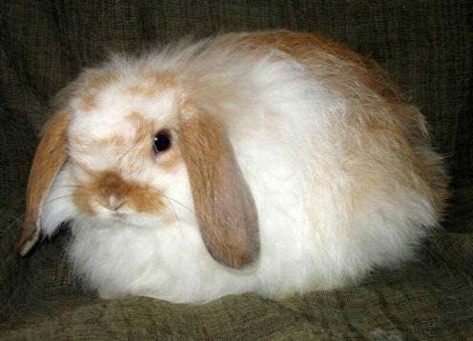
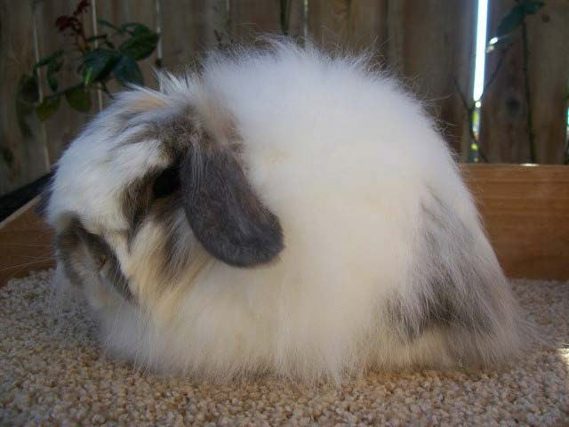
AMERICAN FUZZY LOP
Similar Body type to the Holland Lop, but with wool like an angora.
Compact body that appears muscular.
• Weight 3.5 – 4.0 Pounds
Solid or Broken Colors

Slide 3
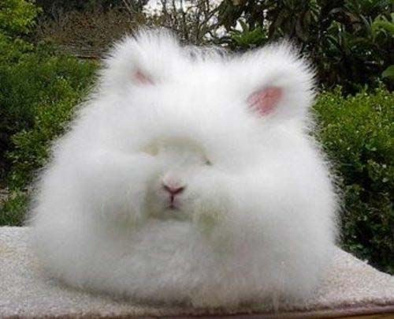
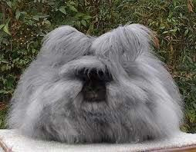
ANGORA
The oldest type of domestic rabbit.
Popular pets of French Royalty
Bred for their angora wool which is finer and softer than cashmere.
3.5 to 4 Pounds

Slide 4
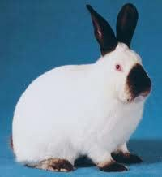
CALIFORNIAN
good meat breed that also has a good quality pelt.
Second most popular meat breed.
Big ears and moderate in size.
  7-12 Pounds

Slide 5
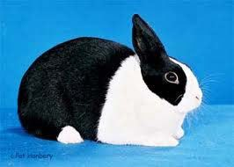
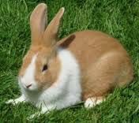
DUTCH
One of the top 10 most popular breeds in the world.
Dutch are to have a compact, well-rounded body; rounded head; short, stocky, well-furred ears; and short, glossy "flyback" fur.
Six colors (in conjunction with white) are recognized for show:
Small 3.5-5.5 Pounds

Slide 6
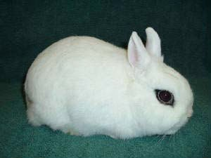
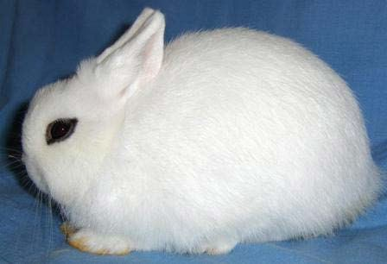
DWARF HOTOT
Small compact and docile rabbit.
Head is round with a broad skull, no visible neck.
Body is uniform in width from hip to shoulders.
Eyes and Eye Band should be dark.
Ideal weight 2.5 Pounds

Slide 7
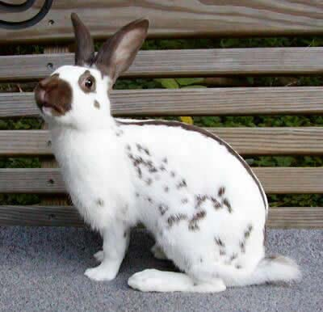
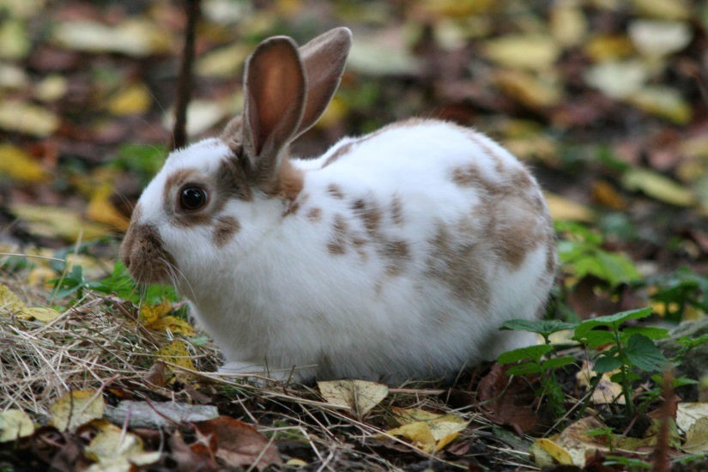
ENGLISH SPOT
One of the oldest rabbit breeds.
Medium Sized Breed
8 Pounds
Spotted Markings
Arch Type Body

Slide 8
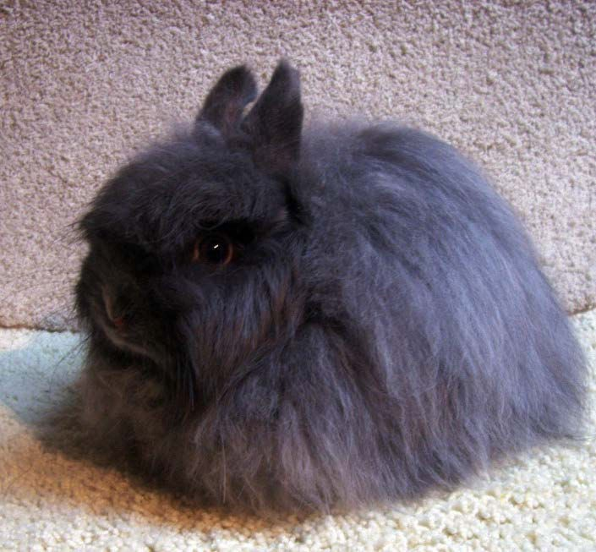
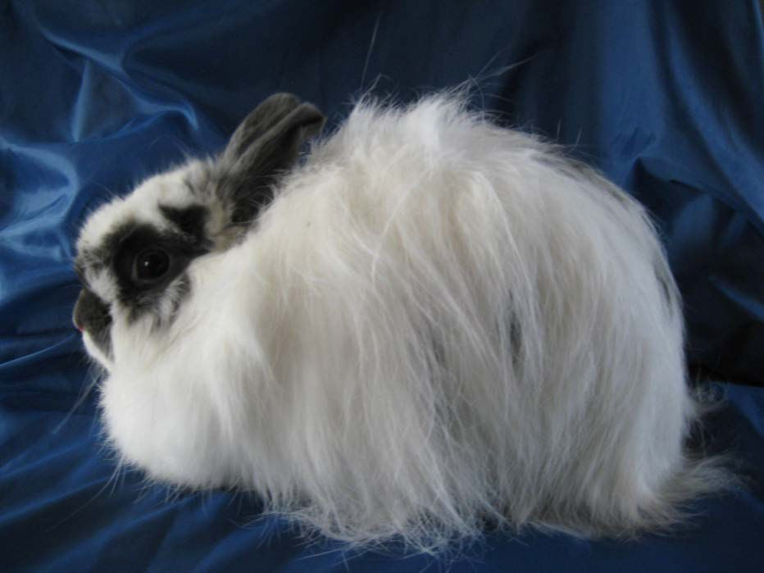
JERSEY WOOLY
Small Rabbit
• 2.5-3.5 Pounds
Compact body type with small erect ears.
Square heads and wool similar to an angora.
Affectionate and playful.

Slide 9
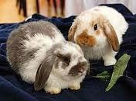
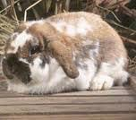
HOLLAND LOP
They are popular house pets for their sweet temperament and nonaggressive behavior.
Compact in Size and Attractive.
2 to 4 Pounds

Slide 10
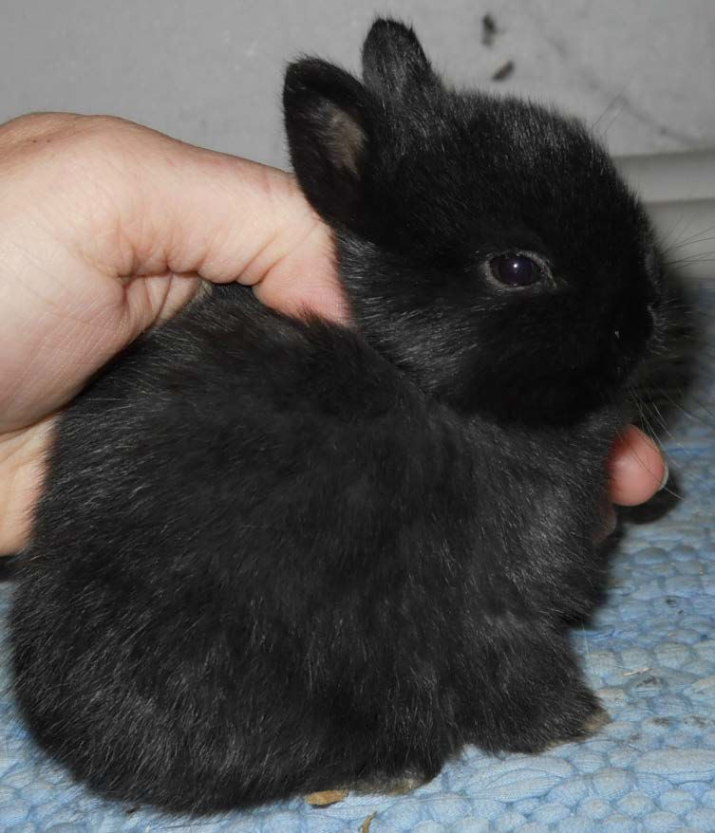
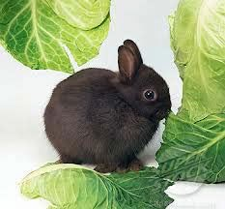
NETHERLAND DWARF
Small popular pet
1.5 to 3.5 Pounds
Head and eyes are very large compared to the body.
Can be trained like a dog or cat.

Slide 11
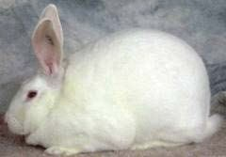
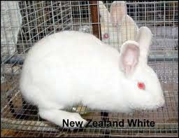
NEW ZEALAND
Large muscular Bodies
10 to 12 Pounds
Most popular meat breed
Bright eyes
Snowy Fur with short fur on the ears revealing skin.

Slide 12
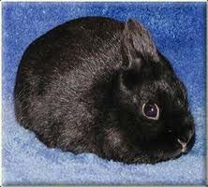
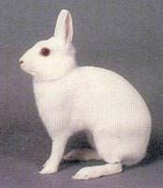
POLISH
Small show rabbit
2.5 to 3 Lbs.
Ears touch each other all the way to the tips.
Calm, quiet and friendly.

Slide 13
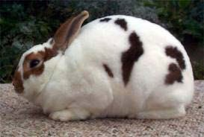
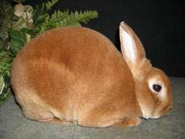
MINI REX
Their small size, plush coat and friendly personalities make them one of the most popular Rabbit Breeds in the United States.
3.5 to 4.5 Pounds
Well rounded back, strong shoulders and legs, with a short neck.

Slide 14
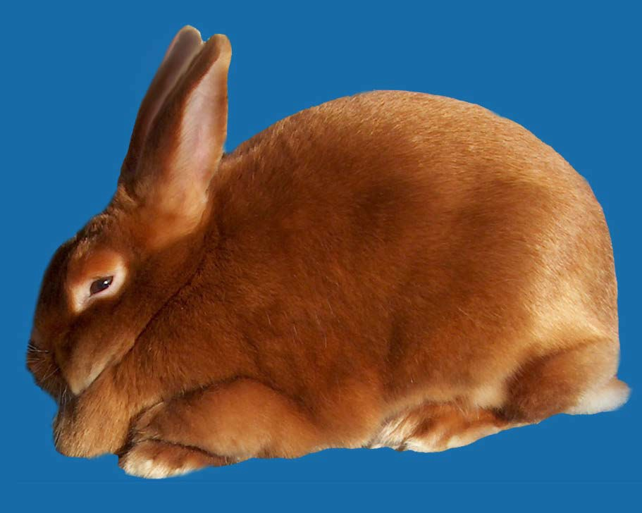
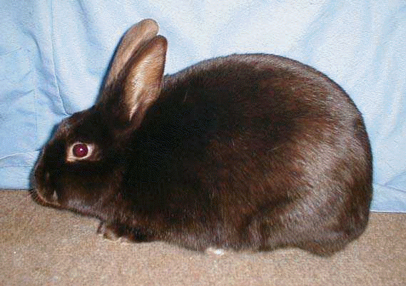
SATIN
Medium to Large breed.
9 to 11 Pounds.
Known for its super shiny and fine textured fur.
Also a great meat rabbit.

Slide 15
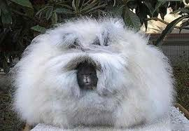
PRACTICE

Slide 16
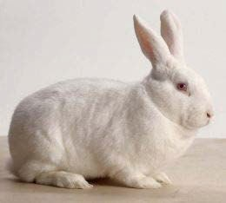
PRACTICE

Slide 17
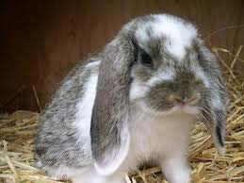
PRACTICE

Slide 18
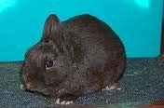
PRACTICE

Slide 19
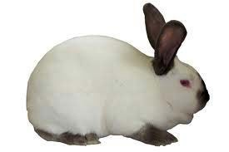
PRACTICE

Slide 20
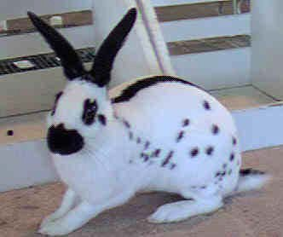
PRACTICE

Slide 21
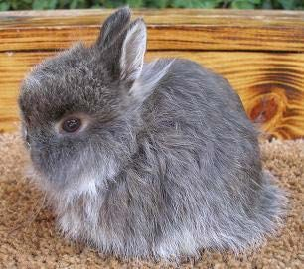
PRACTICE

Slide 22
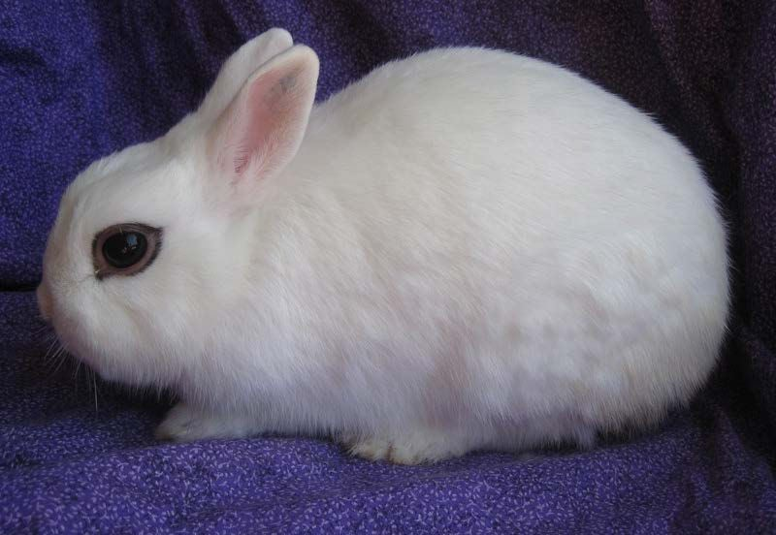
PRACTICE

Slide 23
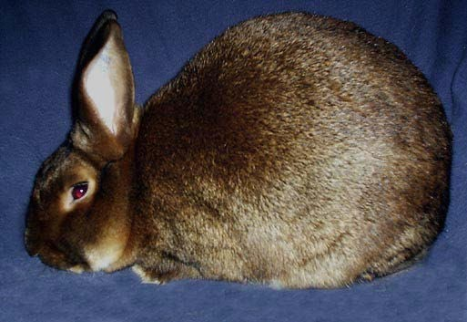
PRACTICE

Slide 24
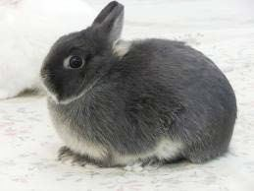
PRACTICE

Slide 25
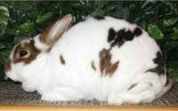
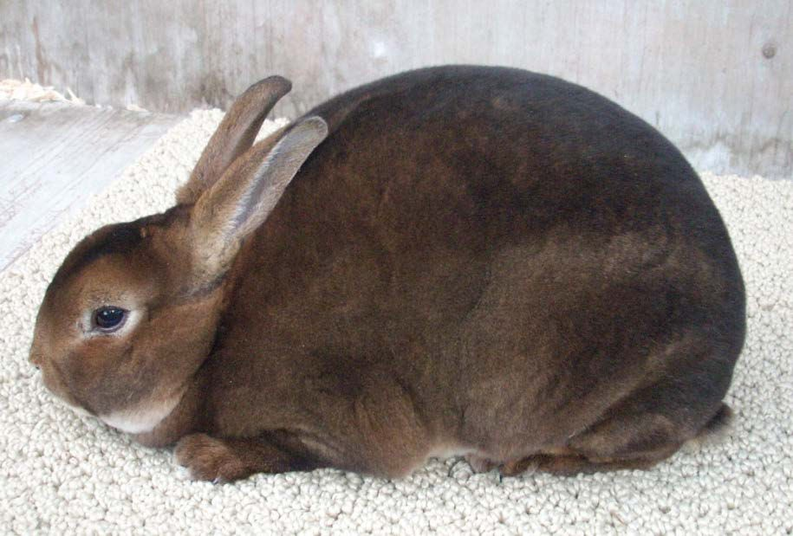
PRACTICE

Slide 26
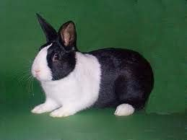
PRACTICE

Slide 27
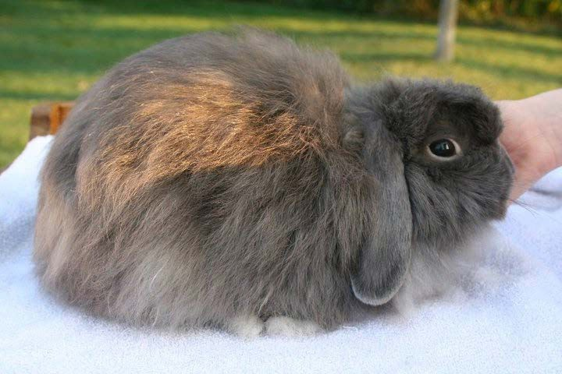
PRACTICE

