Slide 1
Reptiles &
Birds
Vet Science Mrs. Knight

Slide 2
REPTILES

Slide 3
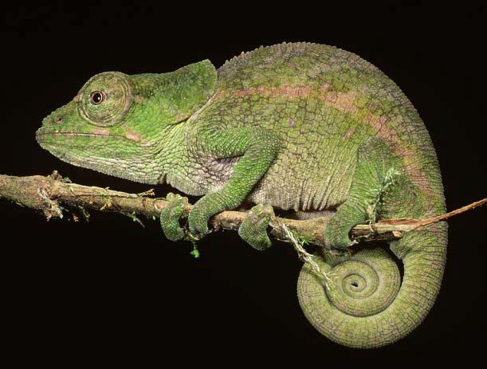
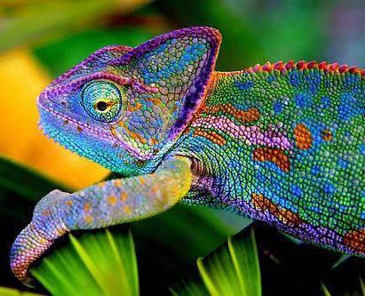
Chameleon
 Specialized Lizard
 160 species that come in many colors:
 Pink, green, blue, orange, teal, red, and yellow.
 Long tongue and stereoscopic eyes.

Slide 4
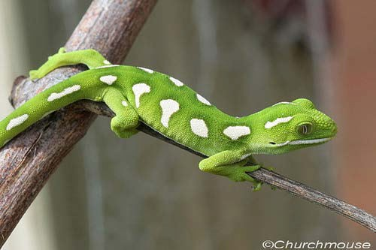
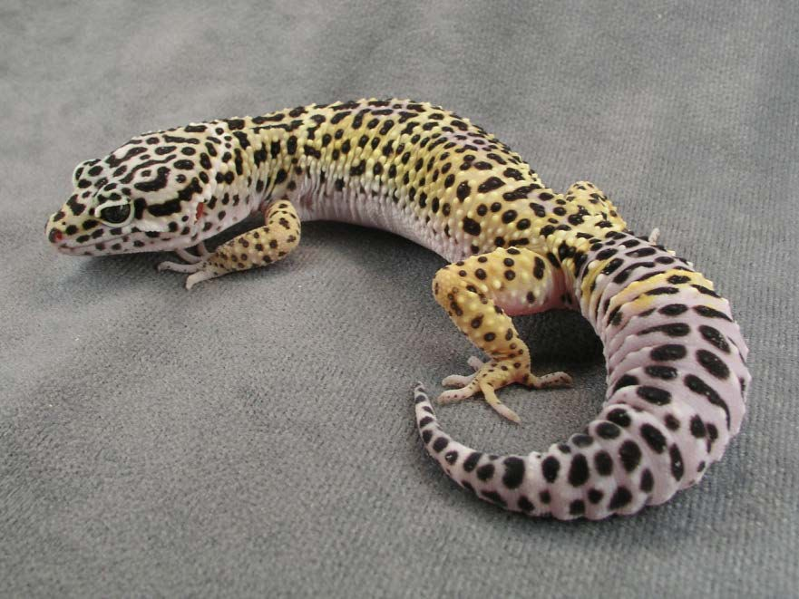
Gecko
 Have no eyelids and lick eyes to clean an moisten.
 Over 1500 species.
 Have specialized toe pads that allow them to climb vertical smooth surfaces.
 Have excellent night vision.

Slide 5
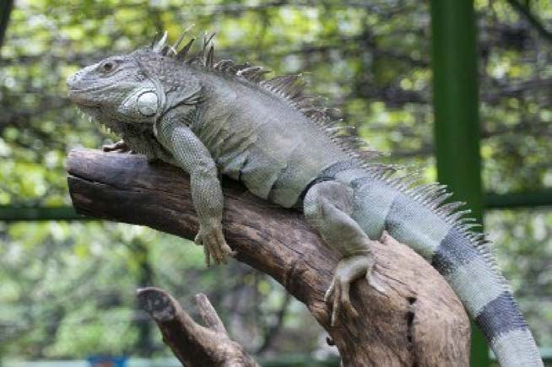
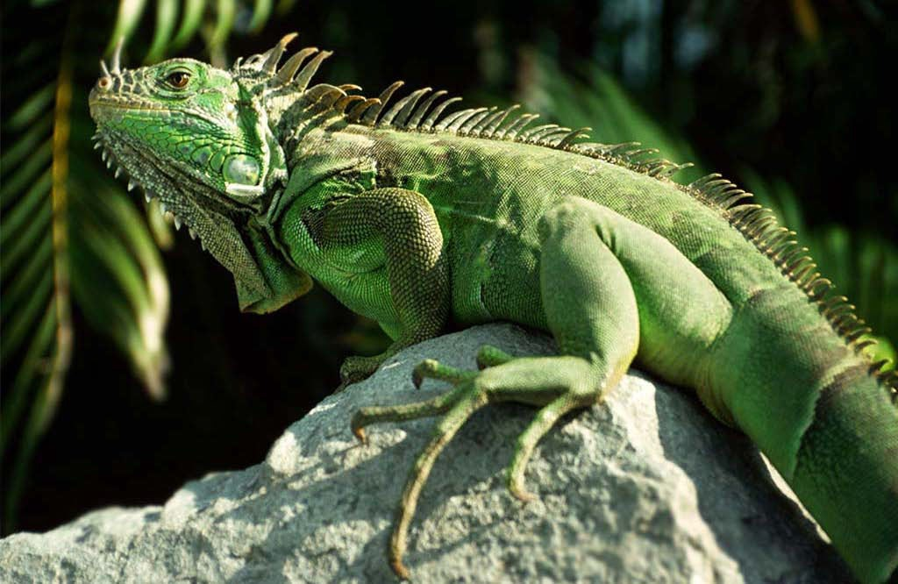
Iguana
 Native to Mexico and Costa Rica.
 The Green Iguana is a popular pet.
 Can be four to six feet long.
 Spines on the back and sharp claws.

Slide 6
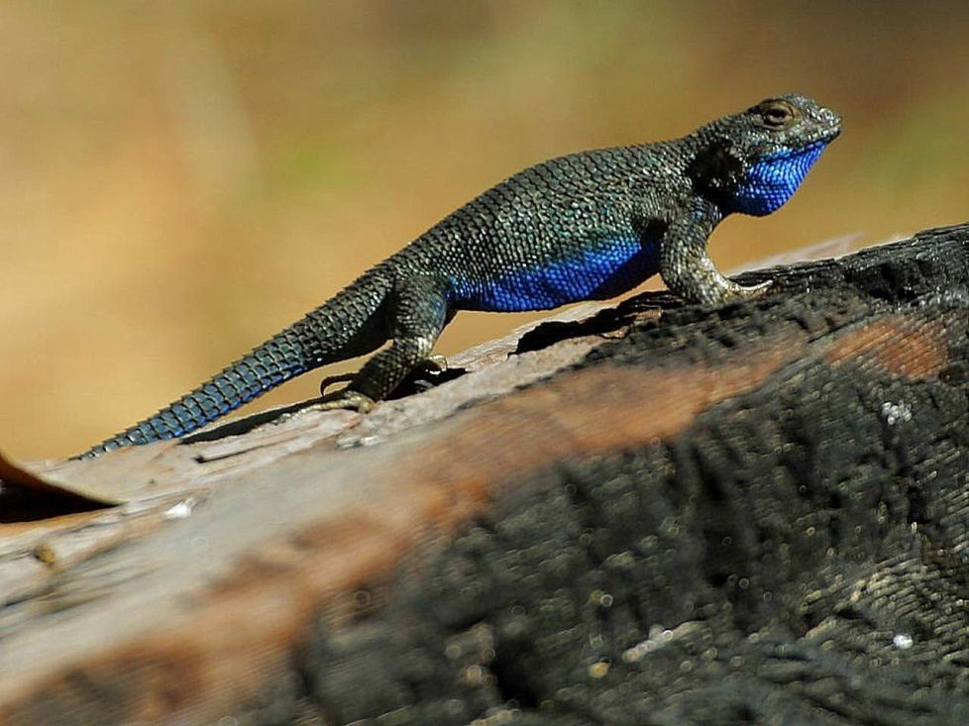
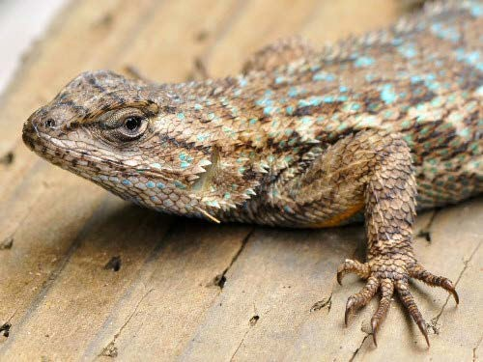
Lizard
 More than 9000 species exist.
 Differ from snakes as they have feet and external ears.
 Many lizards can detach their tails as a method of escape from predators.

Slide 7
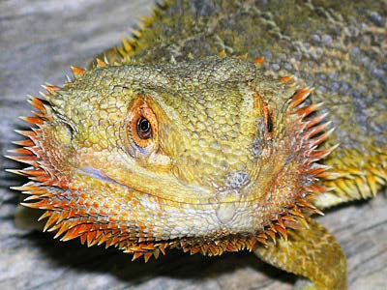
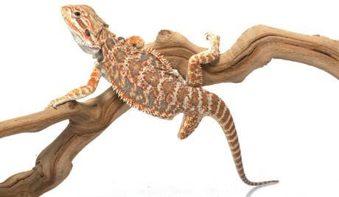
Bearded Dragon
 Live in rocky arid regions.
 Great climbers.
 Broad triangular heads and flattened bodies.
 Spines on neck and in groups along back.
 Popular pets
 12-24 Inches long.

Slide 8
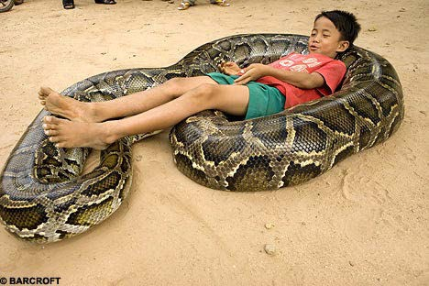
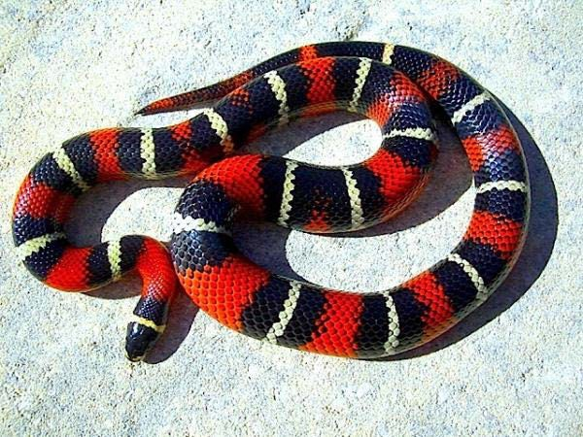
Snake
 Elongated, legless, carnivore.
 Covered in overlapping scales.
 Good at escaping cages.

Slide 9
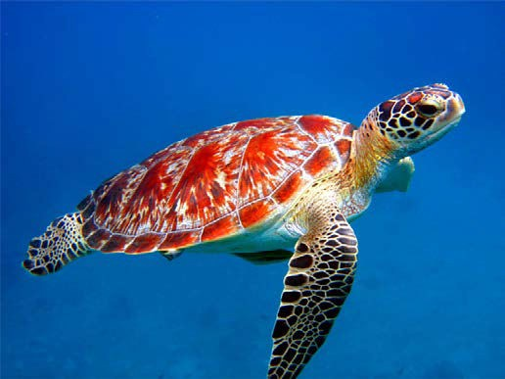
Turtle
 Characterized by a special bony or cartil age
shield developed from their ribs and acting as a shield.
 Land turtles have short sturdy feet.

Slide 10
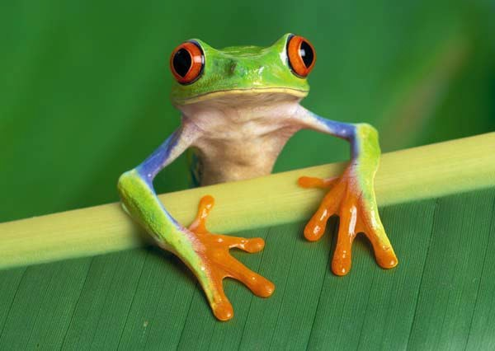
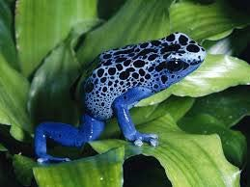
Frog
 Have stout bodies and protruding eyes.
 Frogs can be a lot of work to feed as a pet.

Slide 11
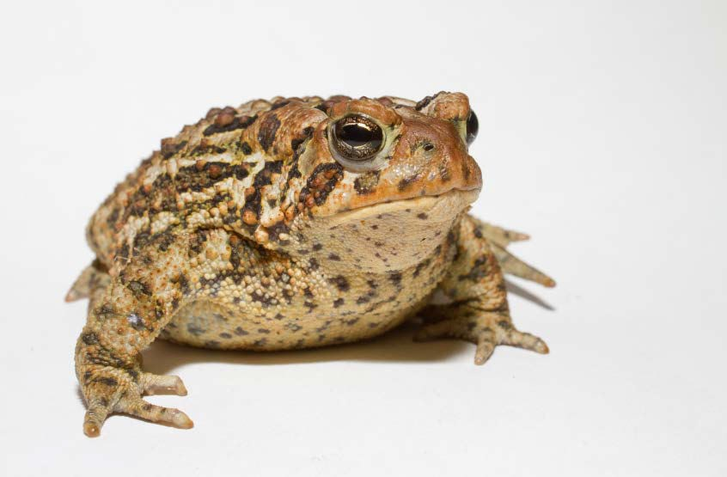
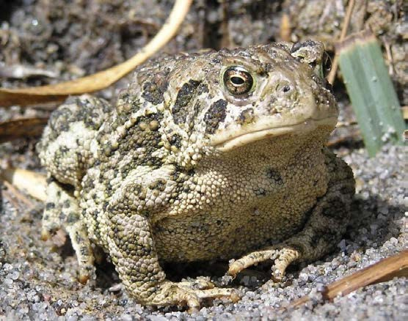
Toad
 Dry, leathery, and bumpy skin.
 Raising toads as pets can be difficult because they require different temperatures and humidity's

Slide 12
BIRDS

Slide 13
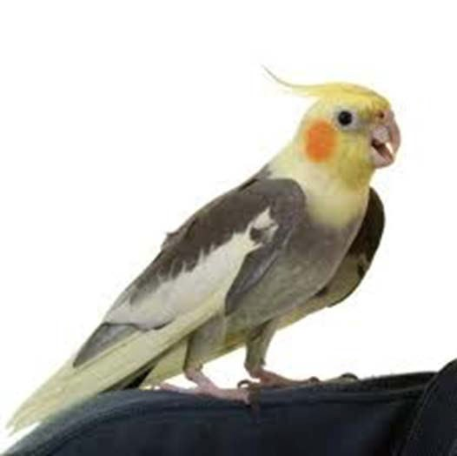
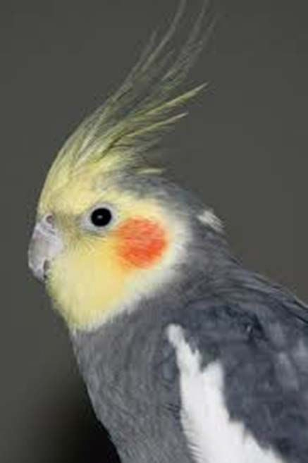
Cockatiel
Small Size
Easy to Train
Great Beginner bird.
Variety of colors

Slide 14
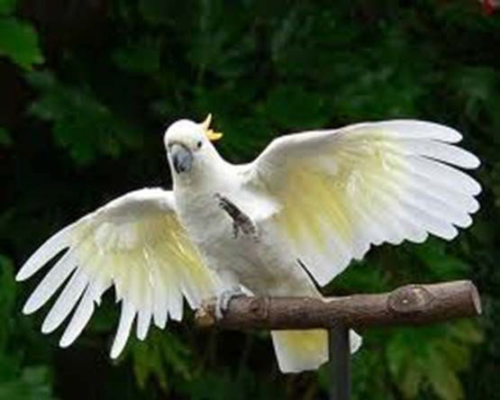
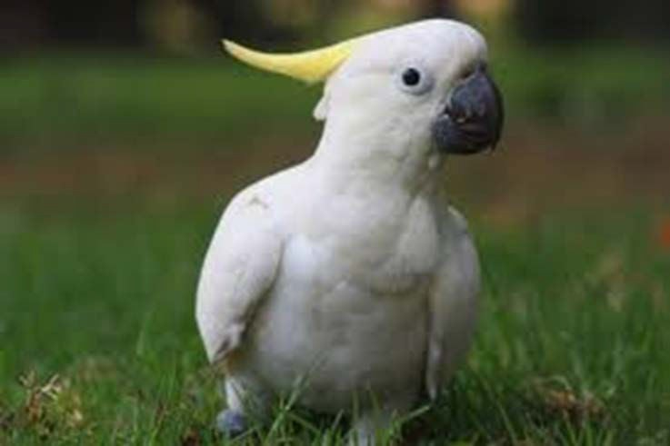
Cockatoo
Large Breed
White Bodies
Have a large vocabulary
Can be loud and can scream for attention.

Slide 15
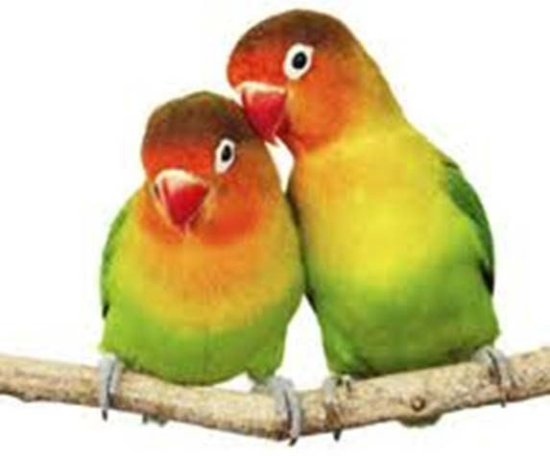
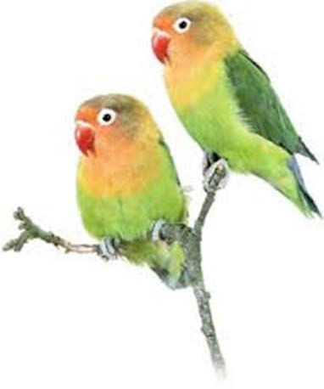
Love Birds
Small and varied in color.
Great in cages.
Originated in Ethiopia.
Easy to tame when young.

Slide 16
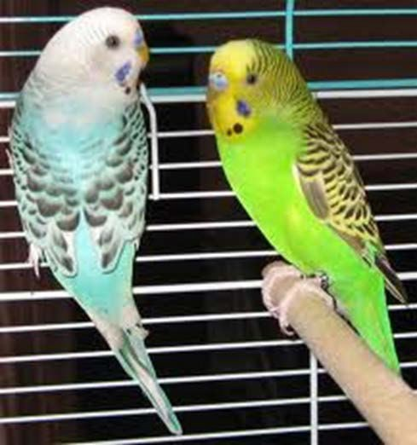
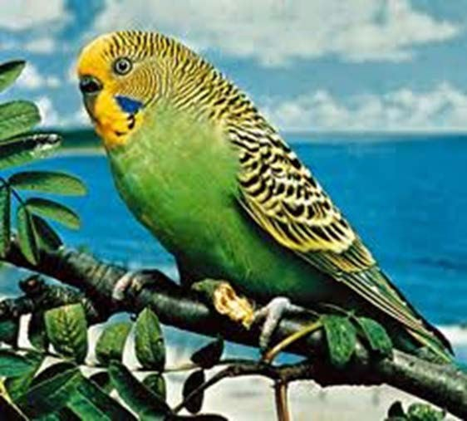
Parakeet
Variety of colors but have black bars over wings and tail feathers.
Small and easy to care for
Originated in Australia.

Slide 17
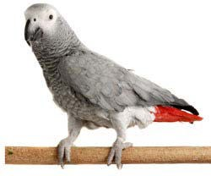
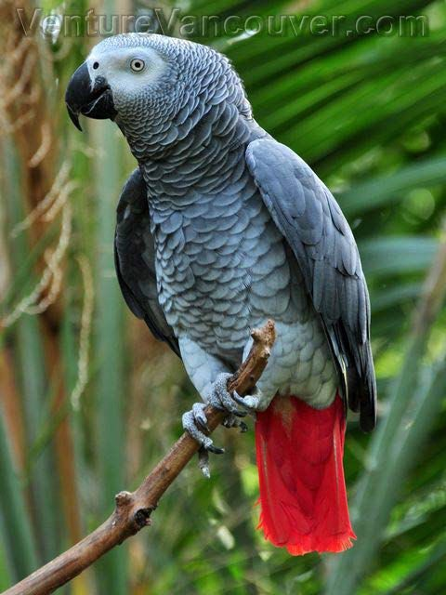
African Gray Parrot
 One of the most intelligent birds.
 Threatened in their natural habitat of the African Rainforest.
 Many sold and traded as pets.

Slide 18
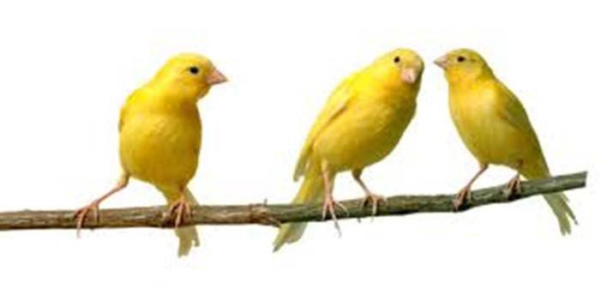
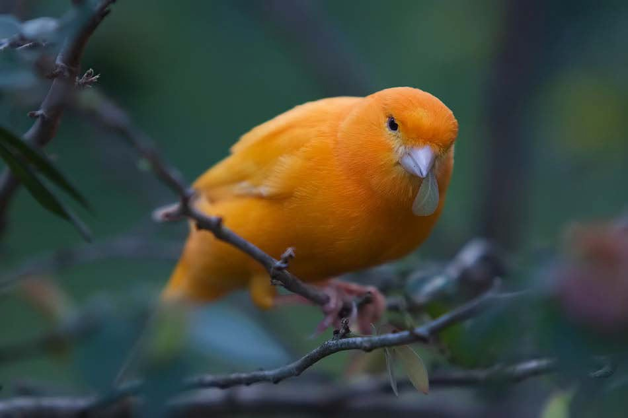
Canary
Small Breed
Solid and Brightly Colored.
Popular Pets that love to sing.
Need larger cages due to activity needs.

Slide 19
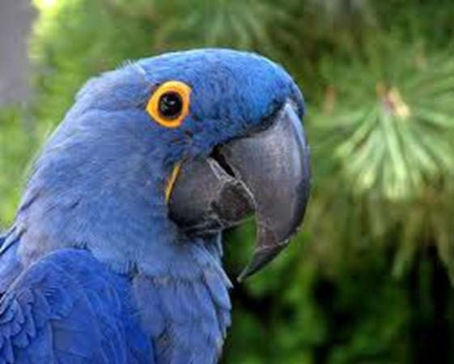
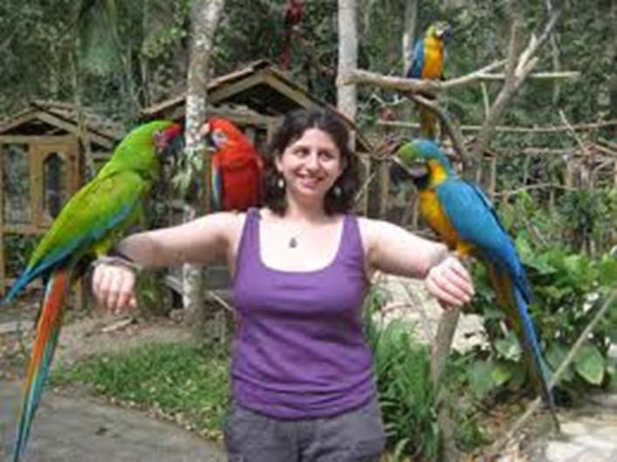
Macaw
Large Breed
Variety of Bright colors.
Smart and get into trouble easily.
Need protection from cold weather.

Slide 20
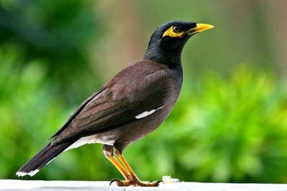
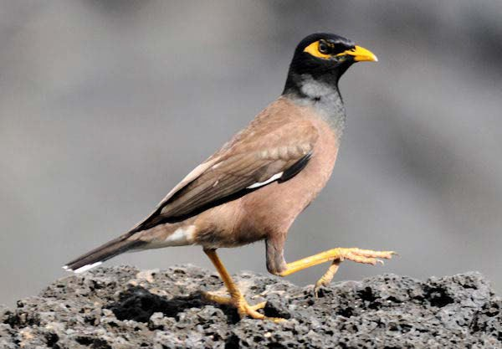
Mynah
 Medium sized with strong feet.
 Plumage is dark usually brown to black.
 Nest in holes.
 Noisy birds but can also learn to say words.

Slide 21
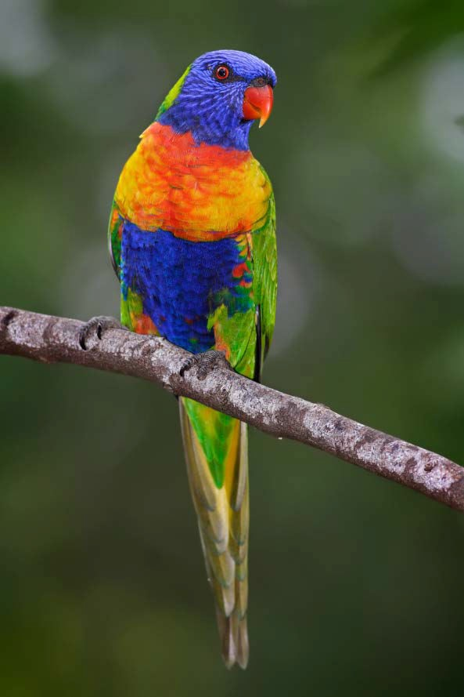
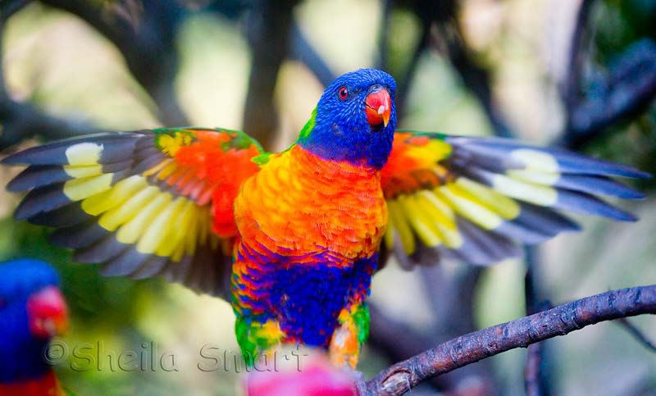
Rainbow Lorikeet
 Species of Australian Parrot.
 Medium sized brightly colored bird.
 Heads are blue with a greenish collar

Slide 22
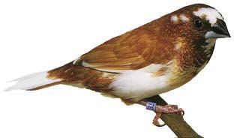
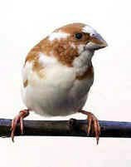
Society Finch
Very Small breed.
Easy to care for.
Originated in Australia and Africa.
Males are more vocal.

Slide 23
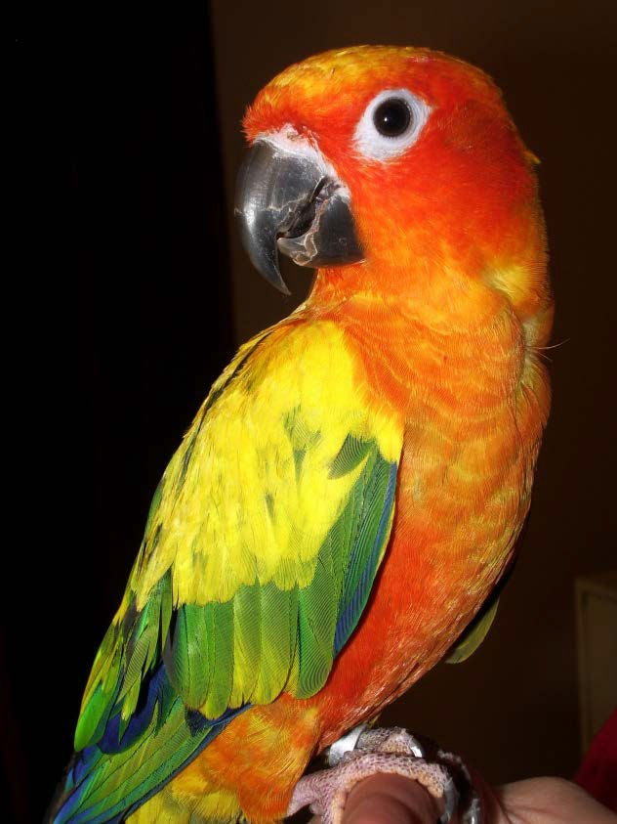
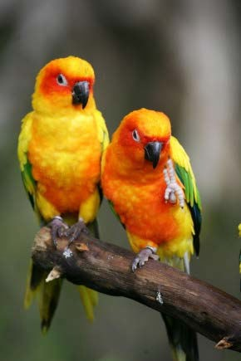
Sun Conure
Medium Sized
Variety of Colors
Originated in South America.
Active and Playful.

Slide 24
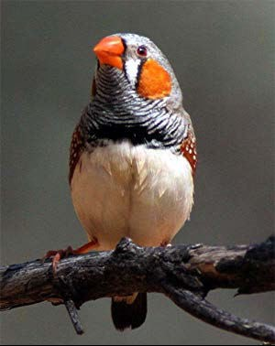
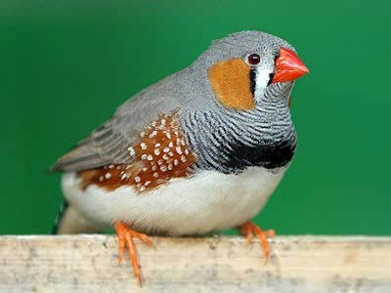
Zebra Finch
 Small bird
 Soft chirping
 Native to Australian Grasslands.
 Live 4-8 Years

Slide 25
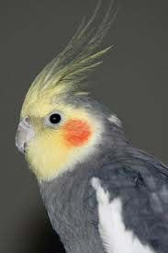
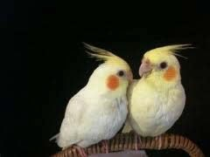
Practice

Slide 26
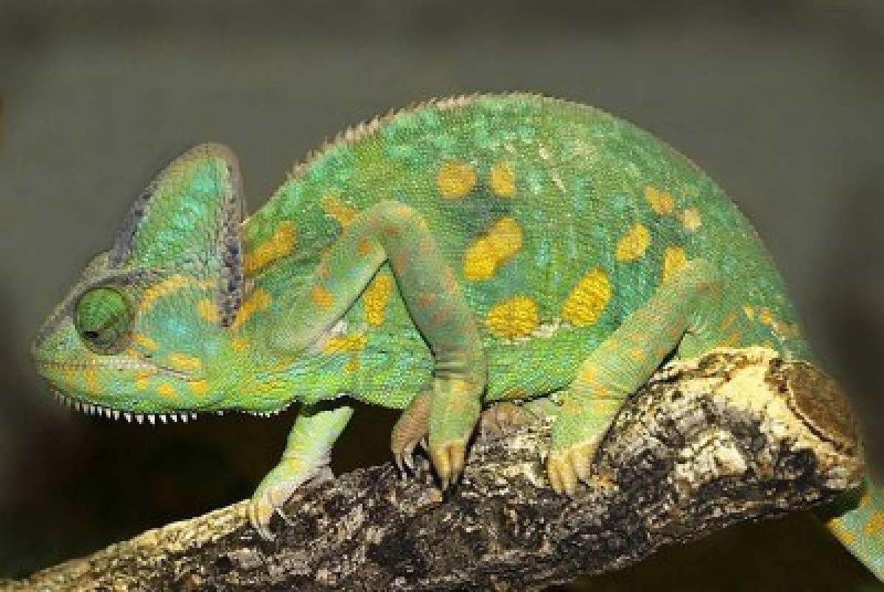
Practice

Slide 27
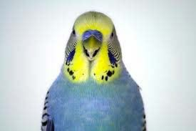
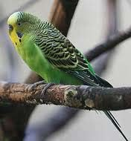
Practice

Slide 28
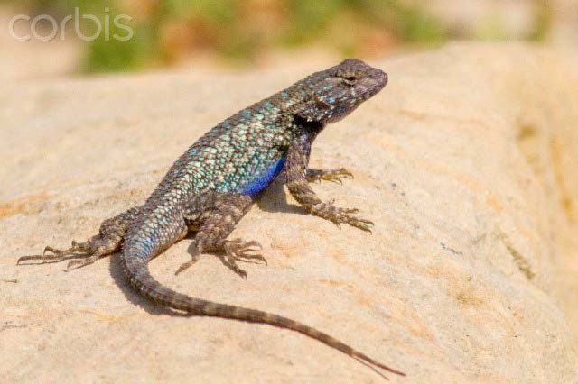
Practice

Slide 29
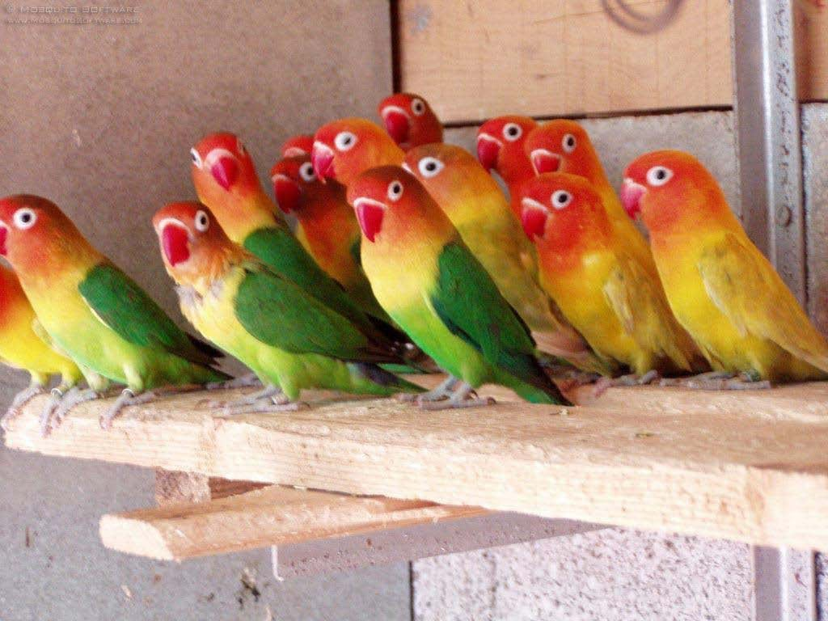
Practice

Slide 30
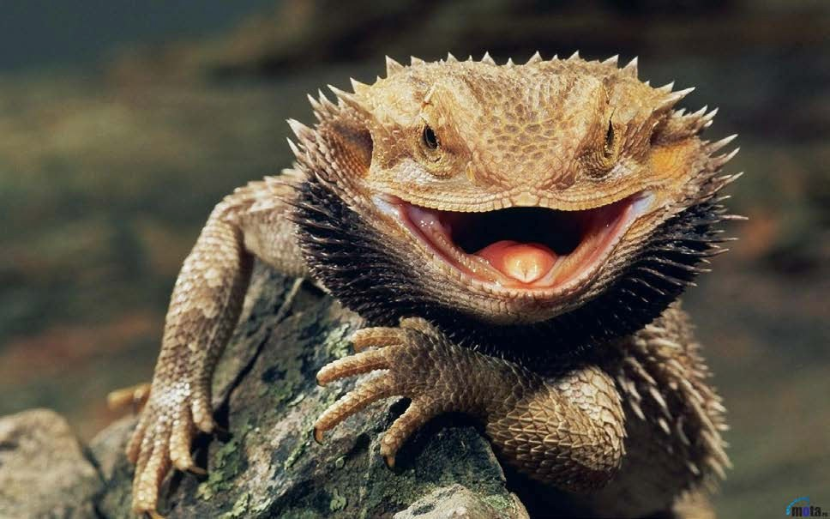
Practice

Slide 31
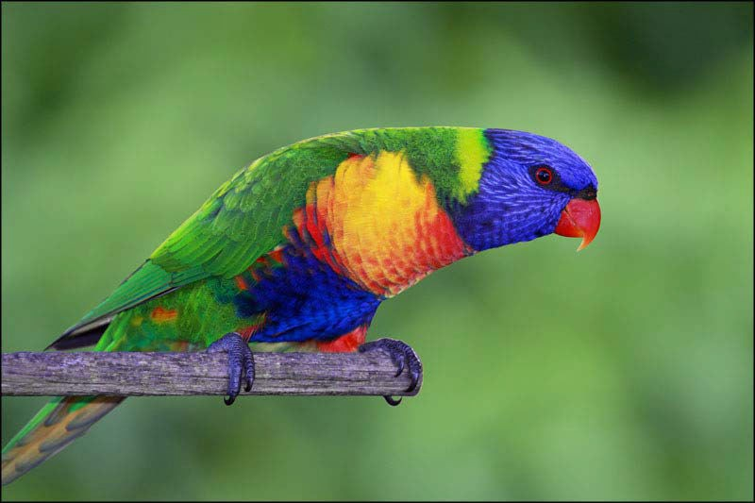
Practice

Slide 32

Practice

Slide 33

Practice

Slide 34

Practice

Slide 35

Practice

Slide 36

Practice

Slide 37

Practice

Slide 38


Practice

Slide 39

Practice

Slide 40

Practice

Slide 41

Practice

Slide 42

Practice

Slide 43

Practice

Slide 44

Practice

Slide 45

Practice

