Slide 1
HORSE BREEDS
Vet Science

Slide 2
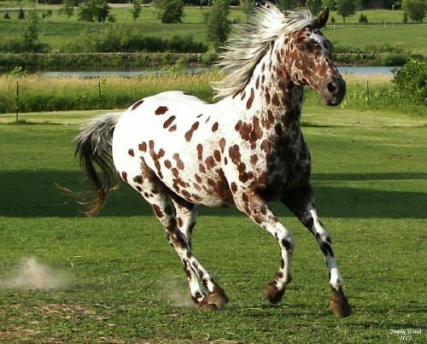
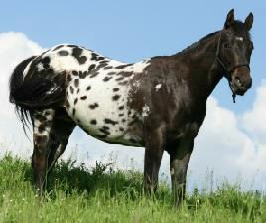
APPALOOSA
Originated in the U.S.
Color
  Variable
  White over the hips and loin, with dark round or egg shaped spots.
  Eye encircled with white
Used by the Nez Perce
Indians
Used for
  Pleasure riding, showing, racing, parades, and as a stock horse.

Slide 3
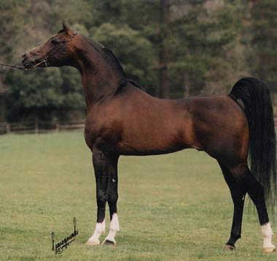
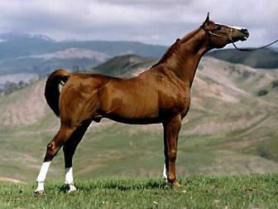
ARABIAN
Originated in Arabia
Small to Medium in Size
Colors
  Mainly gray, bay or chestnut. Some may be black or white.
  Skin is always dark
  Legs and head often
have white markings
Uses
  Pleasure, racing, showing, and as a stock horse.

Slide 4
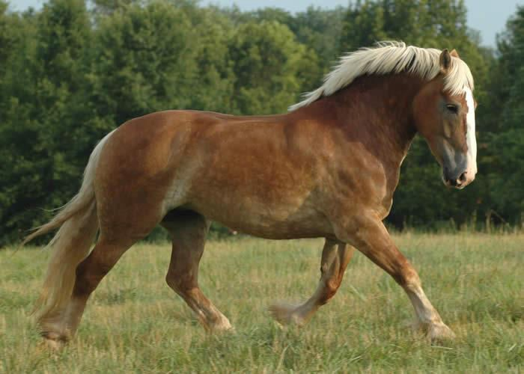
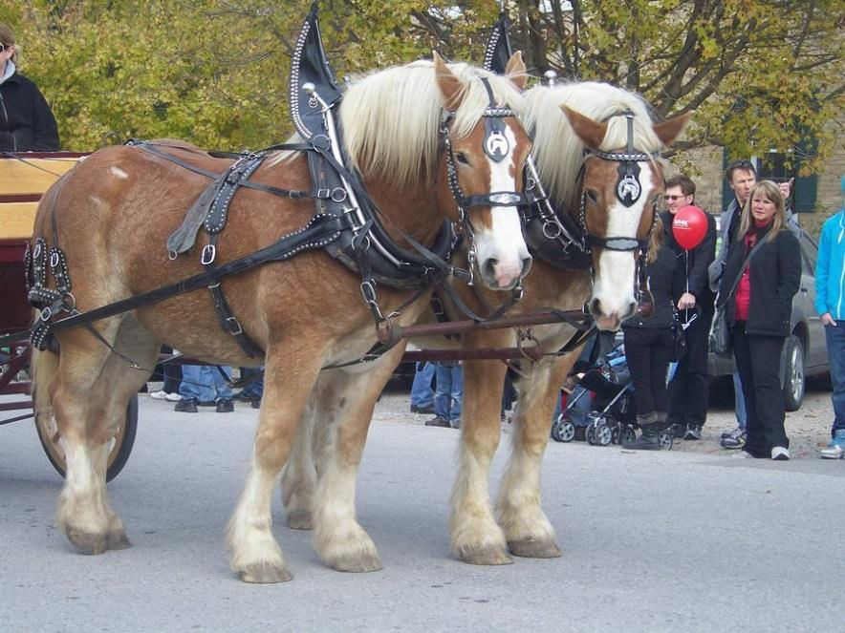
BELGIAN
Uses:
  Draft Horse
Small head, thick and muscular neck, powerful shoulders and quarters, short legs with small amount of feathering.
One of the strongest
draft horses.
Large Horse
  Average Weight 2000lbs.

Slide 5
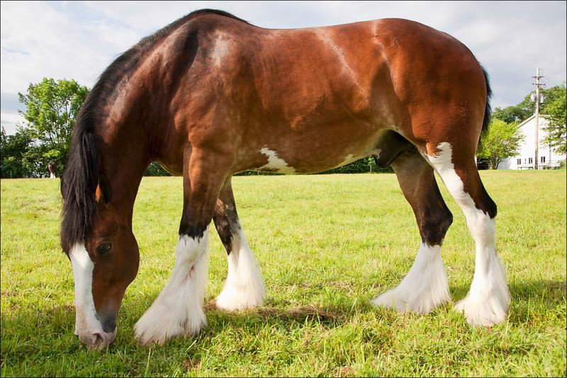
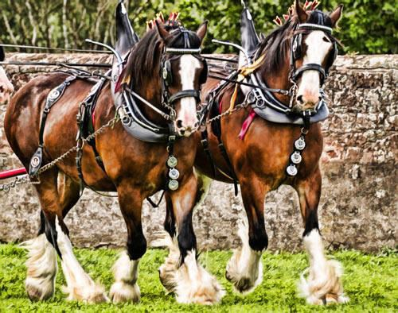
CLYDESDALE
Originated in
Scotland
Uses:
  Draft Horse
Generally bay, with significant white markings and extensive feathering.

Slide 6
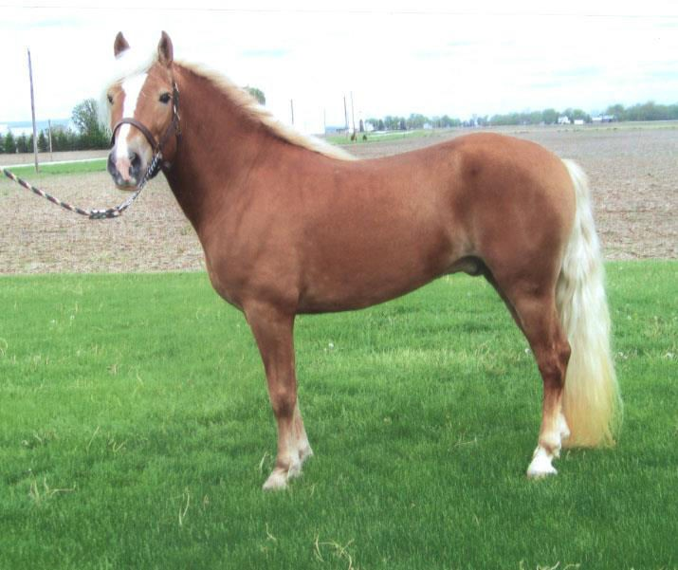
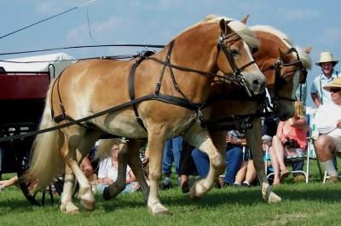
HALFLINGER
Originated in Austria and
Northern Italy.
Small horse, sturdy build, chestnut coloring.
Uses:
  light draft, harness work, and various under-saddle disciplines such as endurance riding, dressage, equestrian vaulting and therapeutic riding

Slide 7
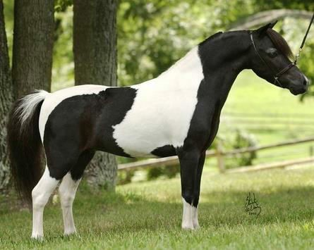
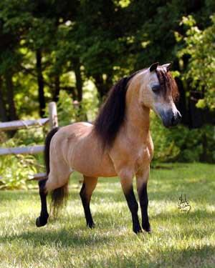
MINIATURE
Small Horse
Uses:
  Pets
  Service or Therapy
Animals
  Diving
  Agility
  Horse Shows
Any horse under 14 hands is technically a pony, but mini horses look more horse like than the stout stocky pony.

Slide 8
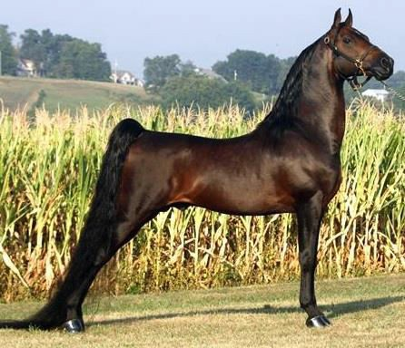
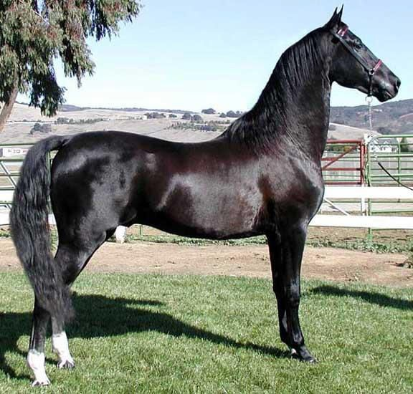
MORGAN
One of the earliest breeds developed in the United States
Compact, muscular but refined build, clean-cut head, well arched neck.
Generally Bay, Black, or Chestnut.
Uses:
  Versatile horse with
many uses.

Slide 9
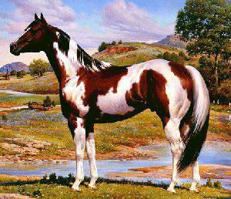
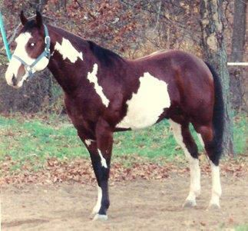
AMERICAN PAINT
Originated in the U.S. from descendants of horses brought by the Spanish
Popular with Indians
and cowboys.
Two color patterns
  Tobiano
    Marking on the head same as solid colored horses.
  Overo
    Variable color head markings

Slide 10
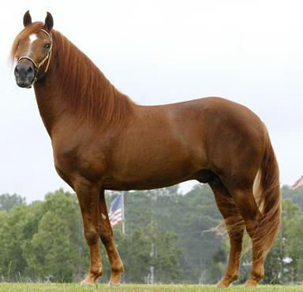
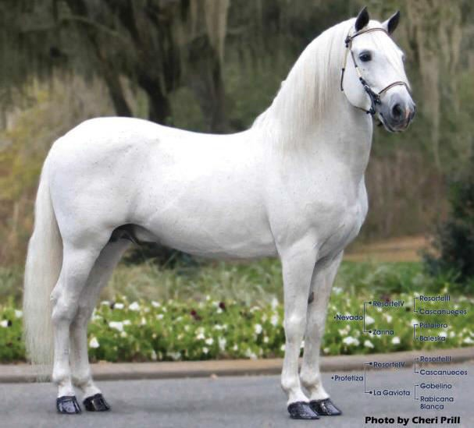
PASO FINO
Originated in Spain
and Puerto Rico
Paso Fino Means
“Fine Step”
  Prized for their smooth 4 beat ambling gait.
Uses:
  Versatile horse
  Popular in trail and
western horse events.

Slide 11
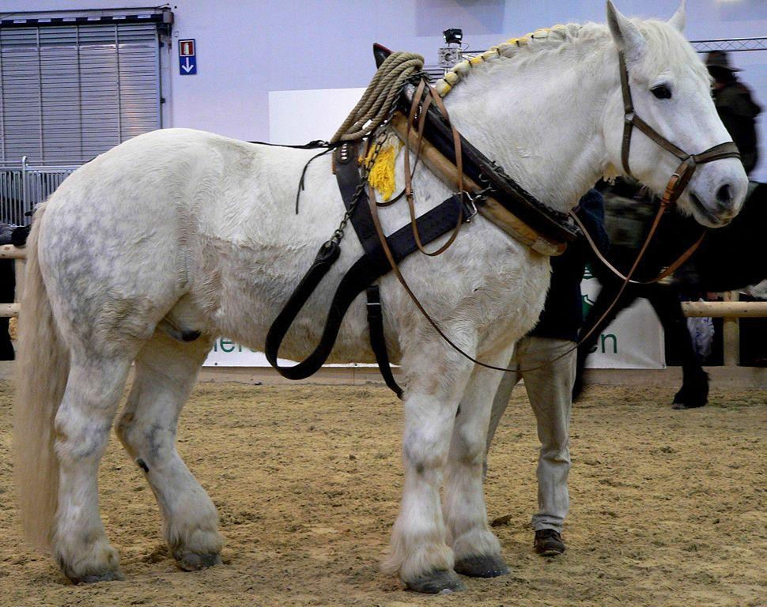
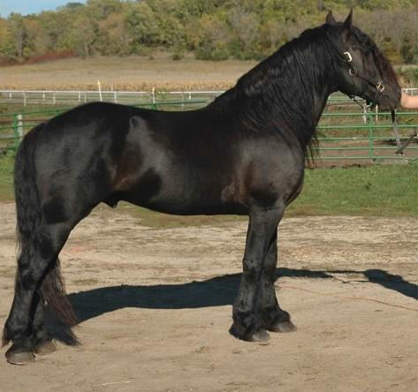
PERCHERON
Originated in France
Usually grey or black and sometimes white.
Clean-limbed, powerful and docile.
Uses:
  Draft work
  Pulling Carriages
  Meat (In France)

Slide 12
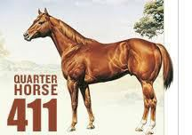
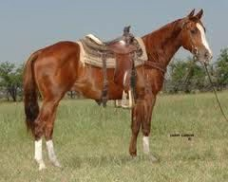
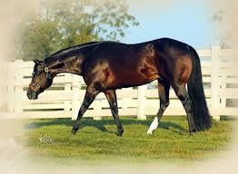
QUARTER HORSE
Originated in the U.S.
Most popular horse in the U.S.
Great sprinting speed over short distances; short, refined head; strong, well- muscled body, featuring a broad chest and powerful, rounded hindquarters
Come in many colors.
Uses:
  Pleasure riding
  Showing
  Racing
  Stock Horses
  Rodeo Events

Slide 13
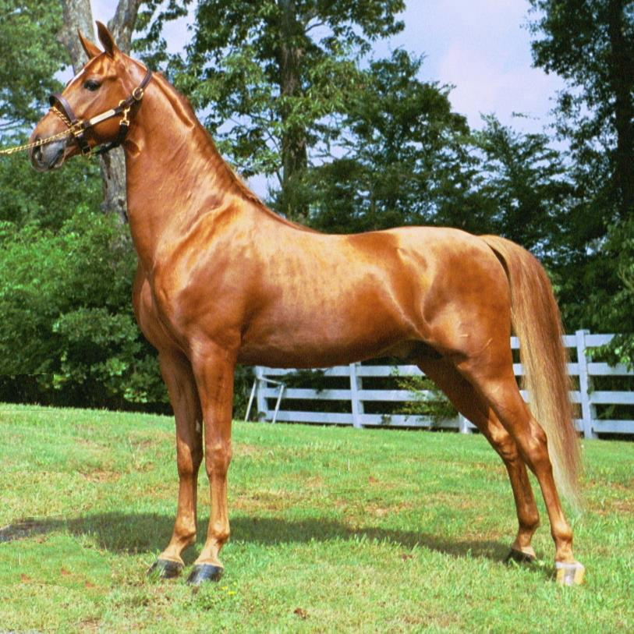
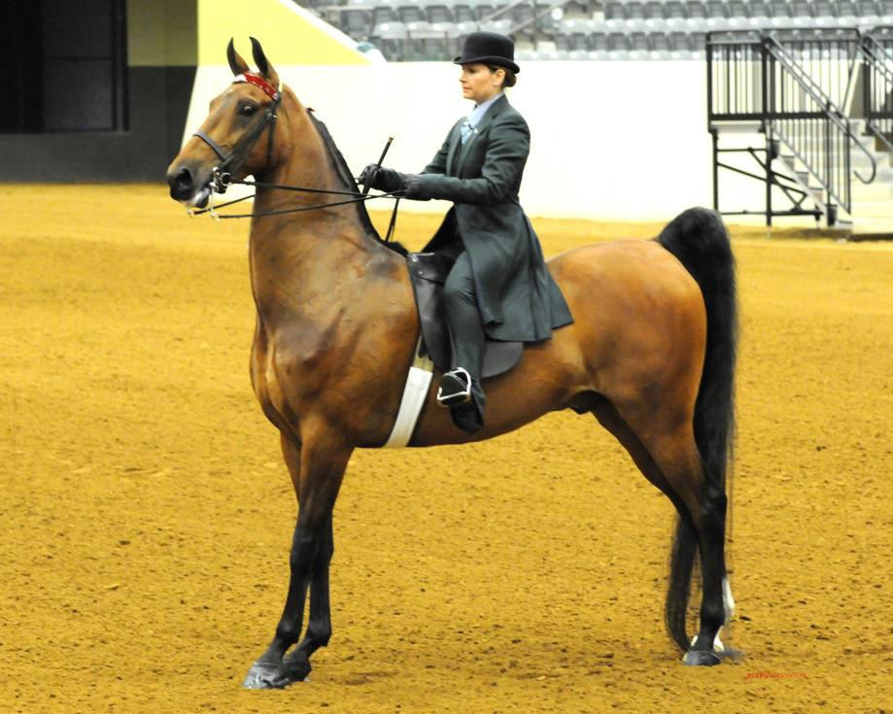
SADDLEBRED
Originated in the
United States
High stepping horse with exaggerated action.
Long slender necks
Uses:
  Horse Shows
  Dressage
  Show Jumping

Slide 14
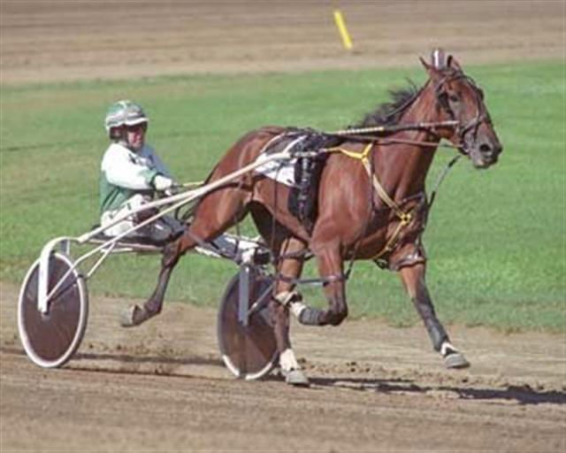
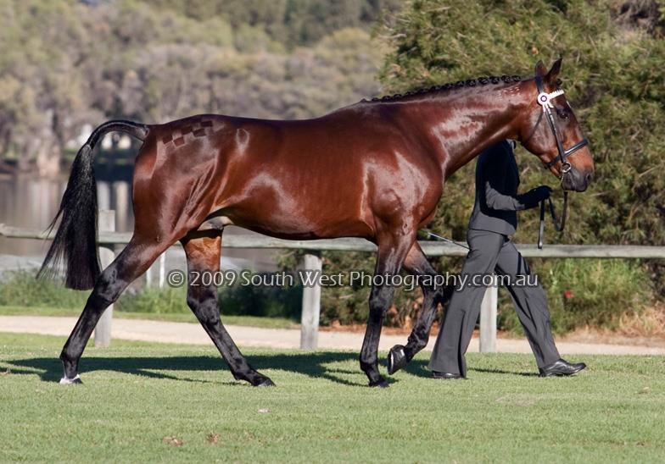
STANDARDBRED (WITH CART)
Originated in the
United States.
Best known for their ability to race in harness at a trot or pace instead of under saddle at a gallop.
Well-muscled, long body, slightly heavier than a Thoroughbred, solid legs and powerful shoulders and hindquarters
Uses:
  Cart Racing

Slide 15
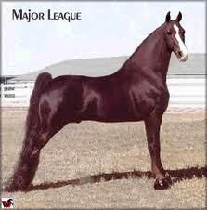
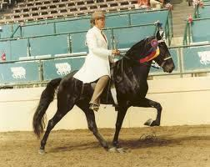
TENNESSEE WALKING HORSE
Originated in the U.S.
Unique "Running Walk," Tall, long neck; calm disposition; long, straight head
Colors:
  Sorrel, chestnut, black, bay, roan, and brown.
  Feet and legs often have
white markings.
Used for
  Pleasure riding
  Showing

Slide 16
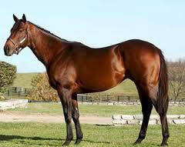
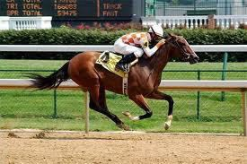
THOROUGHBRED
Originated in England
Tall, slim, athletic horse, developed as a race horse
Colors:
  Bay, Brown, Black, and Chestnut
Used for racing and crossbreeding

Slide 17
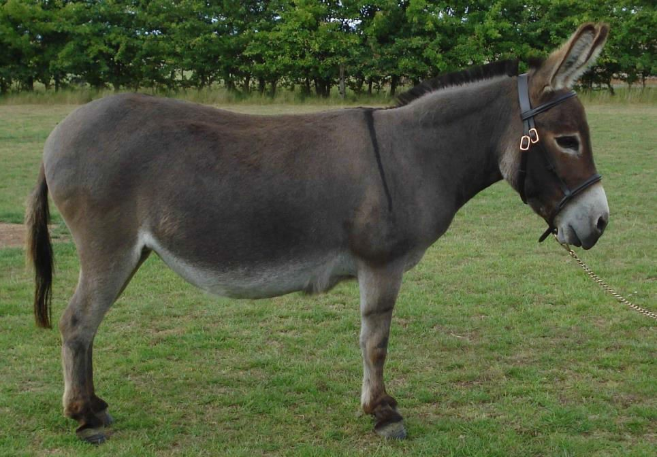
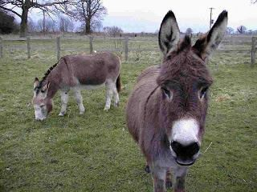
DONKEY
Uses:
  Used for work for more than 5000 years.
Donkeys vary in size but are generally smaller than horses.
They are built to handle desert like conditions

Slide 18
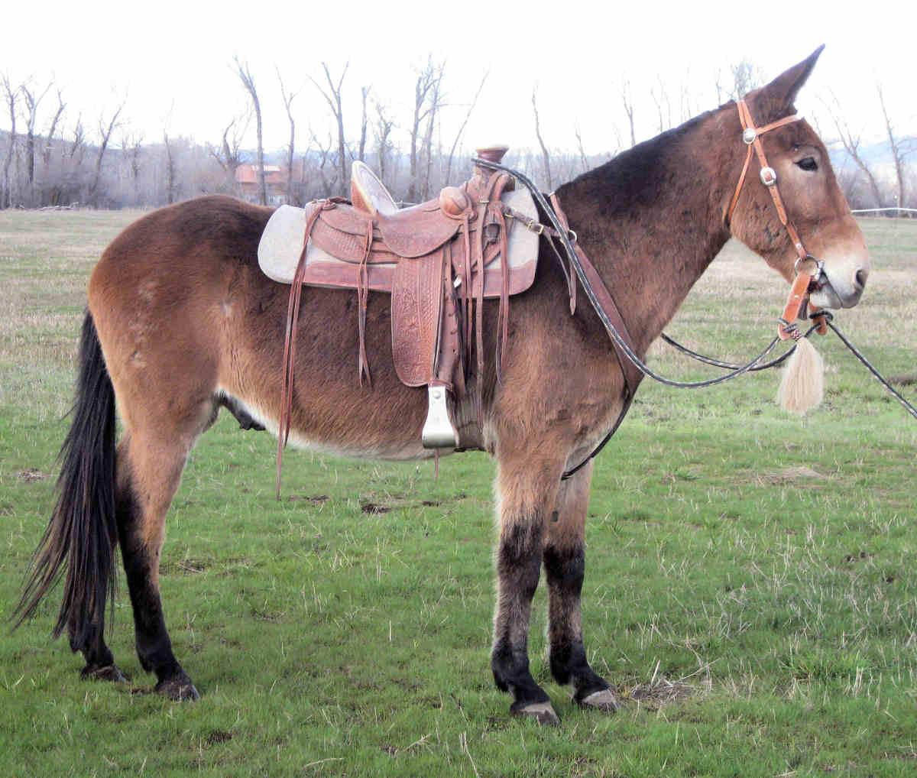
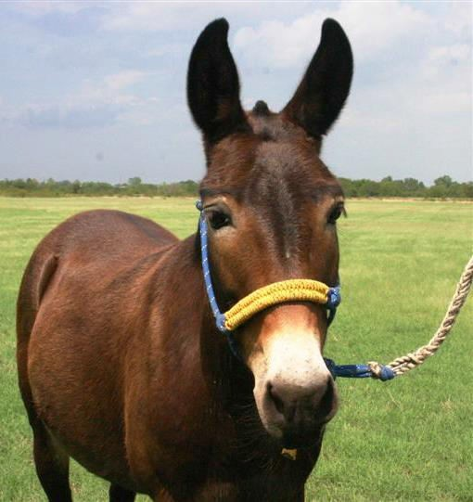
MULE
A mule is the offspring of a male donkey and a female horse
Donkeys and Horses are different species but can reproduce.
  A mule is easier to obtain than a hinny (the offspring of a male horse and a female donkey)
Vary in Size, share donkey
and horse characteristics
  Sterile (Cant Reproduce)
Uses:
  Work
  Packing (Carrying Loads on mountain trails)

Slide 19
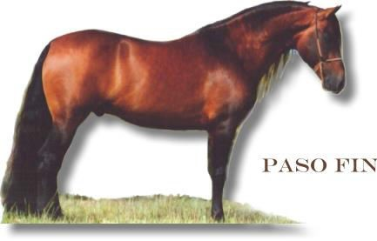
PRACTICE

Slide 20
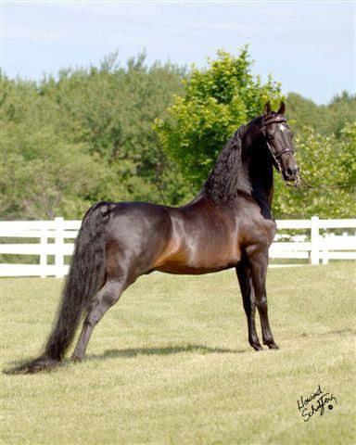
PRACTICE

Slide 21
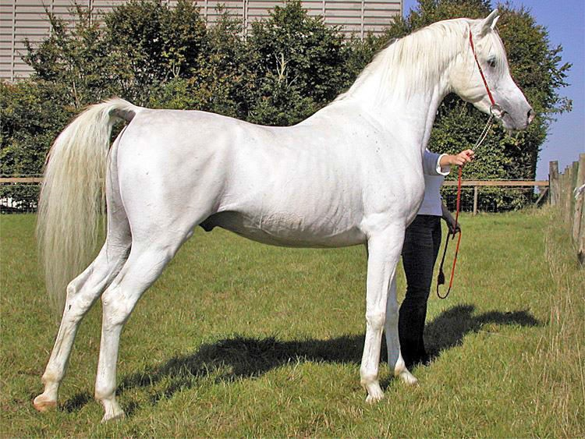
PRACTICE

Slide 22
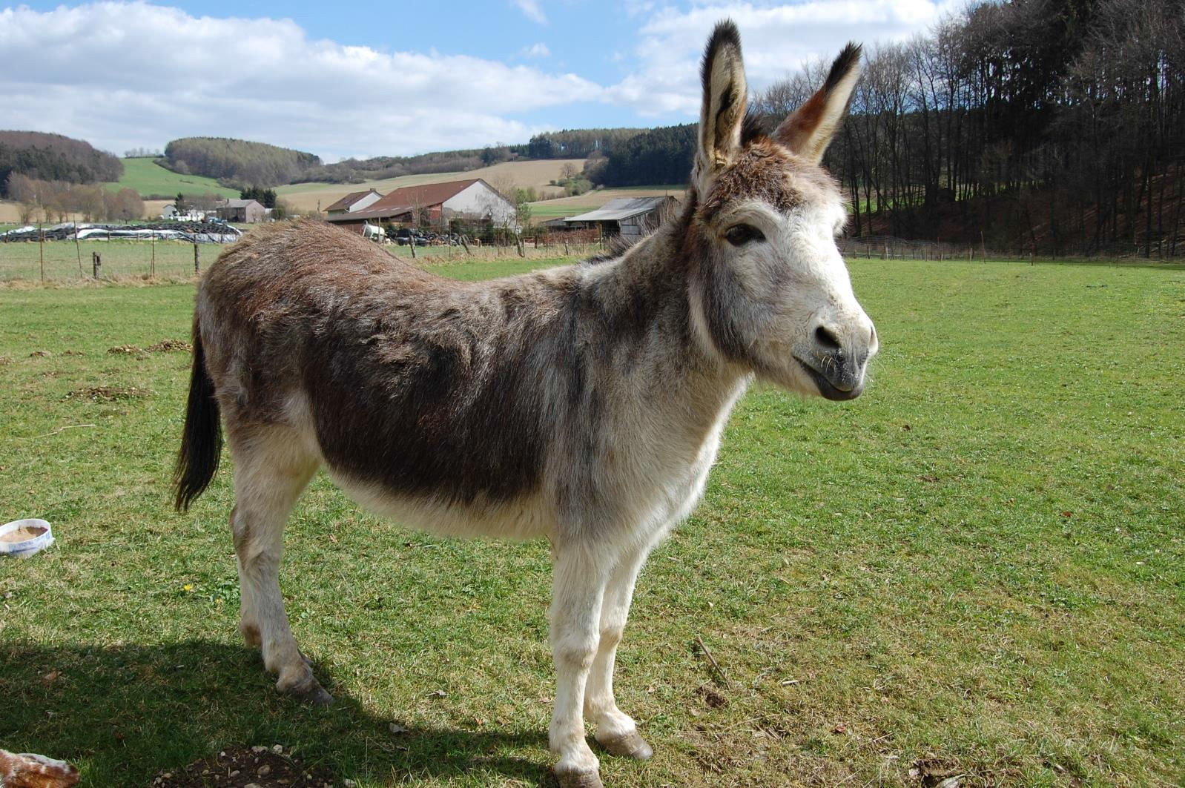
PRACTICE

Slide 23
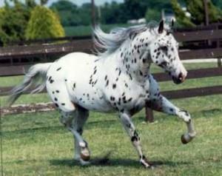
PRACTICE

Slide 24
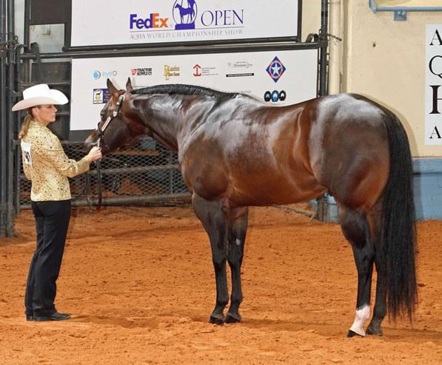
PRACTICE

Slide 25
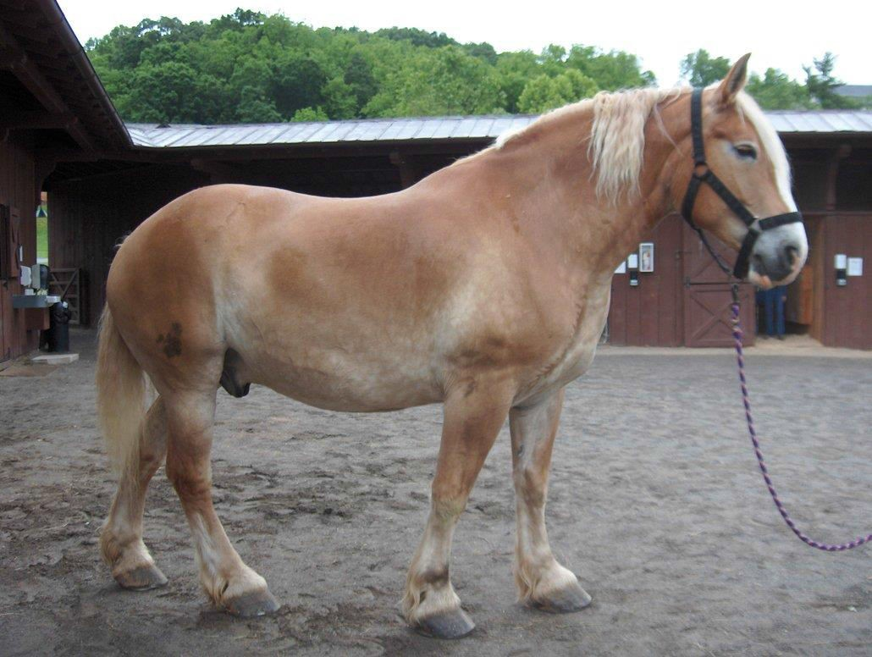
PRACTICE

Slide 26
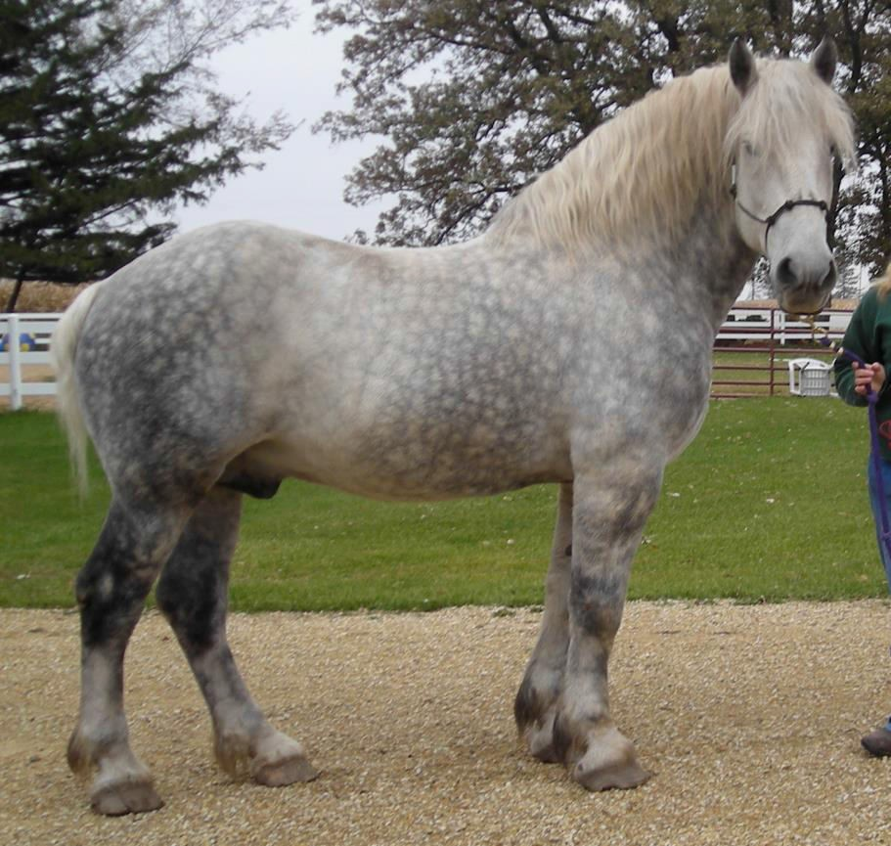
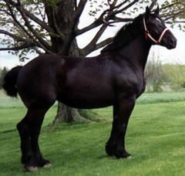
PRACTICE

Slide 27
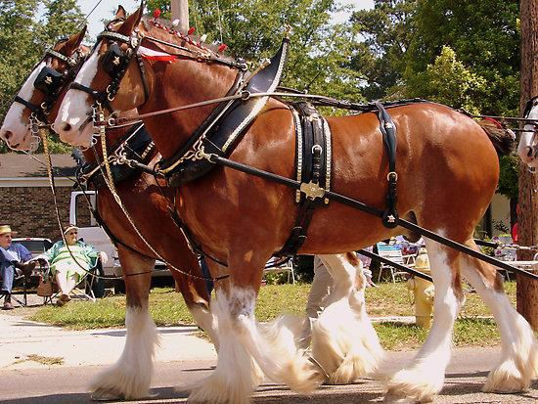
PRACTICE

Slide 28
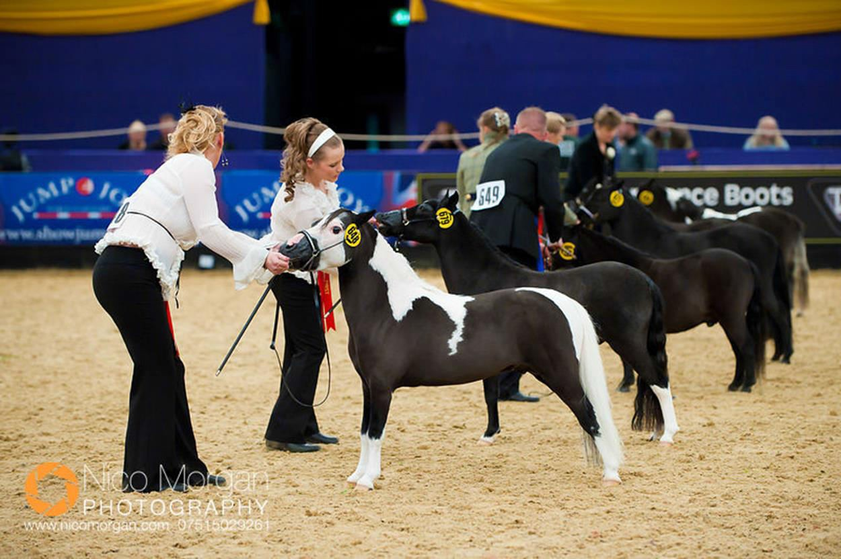
PRACTICE

Slide 29
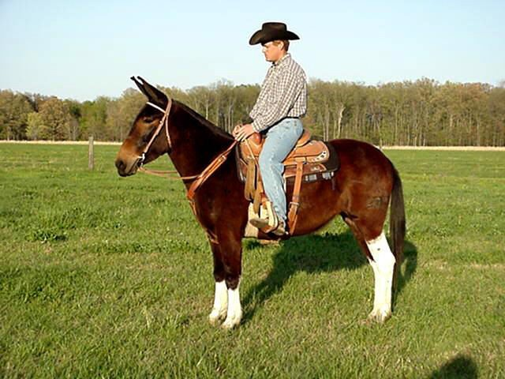
PRACTICE

Slide 30
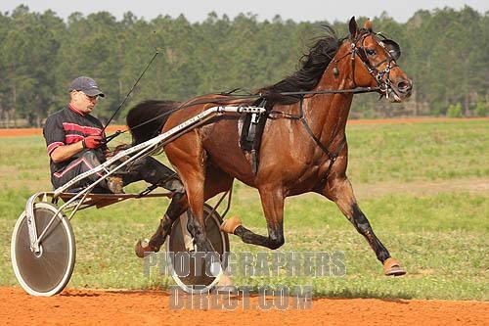
PRACTICE

Slide 31
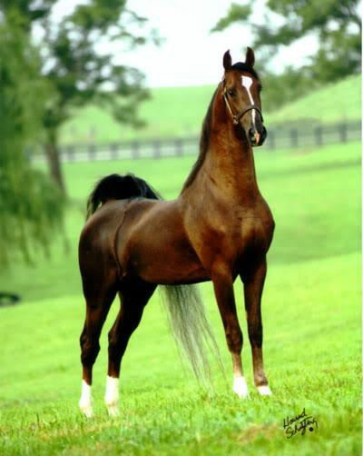
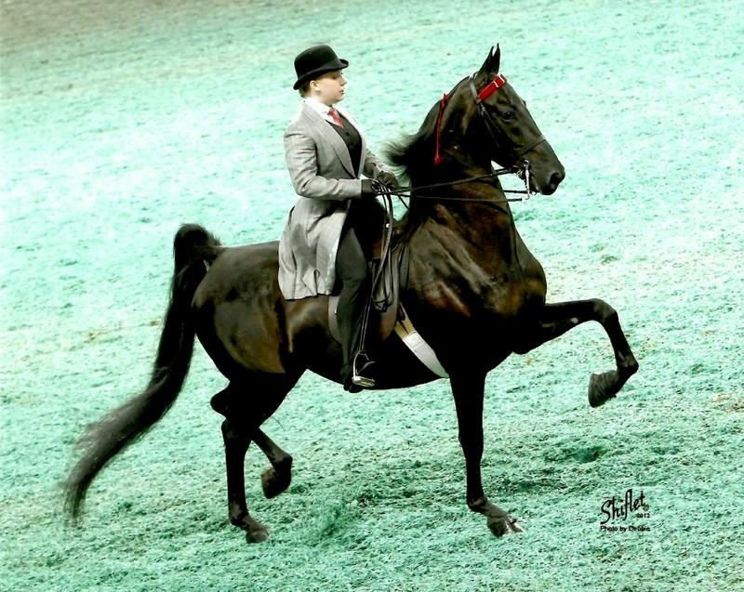
PRACTICE

Slide 32

PRACTICE

Slide 33

PRACTICE

Slide 34


PRACTICE

