Slide 1
Vet Science

Slide 2
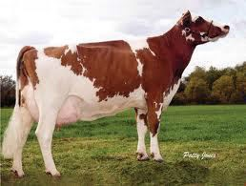
Aryshire
From Scotland
Greatest numbers are found in the Northern U.S.
Preferred color is red and white.
Vigorous and Strong
Great Grazers
3rd in Milk Production

Slide 3
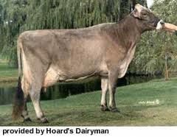
Brown Swiss
From Switzerland
One of the oldest
Dairy Breeds.
Large Framed
Have a quiet docile
temperament.
Live a long time.
2nd ranked breed in
Milk Production.

Slide 4
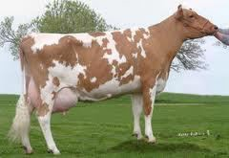
Guernesy
From the English Channel off the coast of France
Can be any shade of fawn with white markings.
Early Maturing Breed
Gentle Behavior
Very Adaptable
Rank 4th in Milk Production.

Slide 5
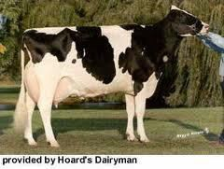
Holstein
From the Netherlands
Black and White
Largest of the Dairy Breeds
Large Feed Capacity
Cows are quiet, while bulls are mean and dangerous.
Ranked 1st in Milk
Production

Slide 6
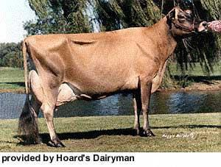
Jersey
From the English Channel off the Coast of France.
Cream to light Fawn to almost black in color.
Black Muzzle.
Smallest of the Diary Breeds.
Efficient feeders
Cows can be nervous and
bulls mean.
5th in Milk production but 1st in Butterfat content.

Slide 7
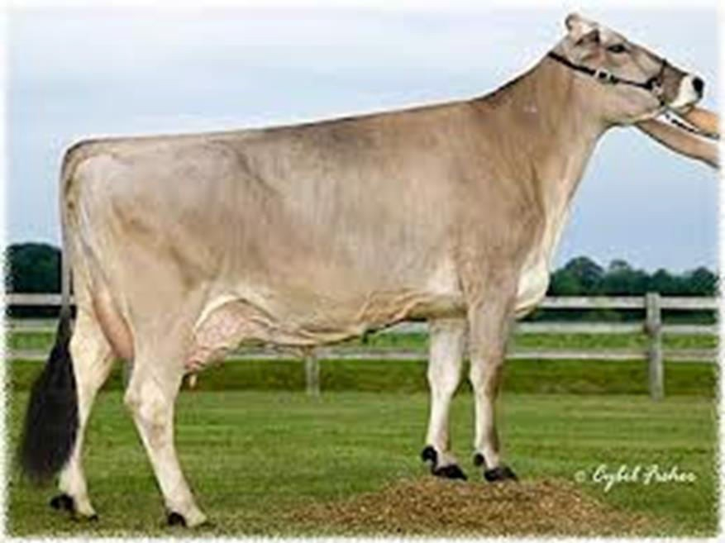
PRACTICE

Slide 8
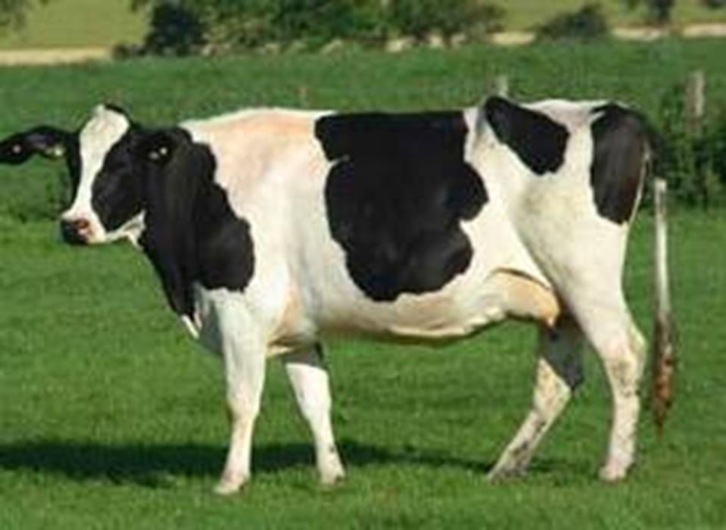
PRACTICE

Slide 9
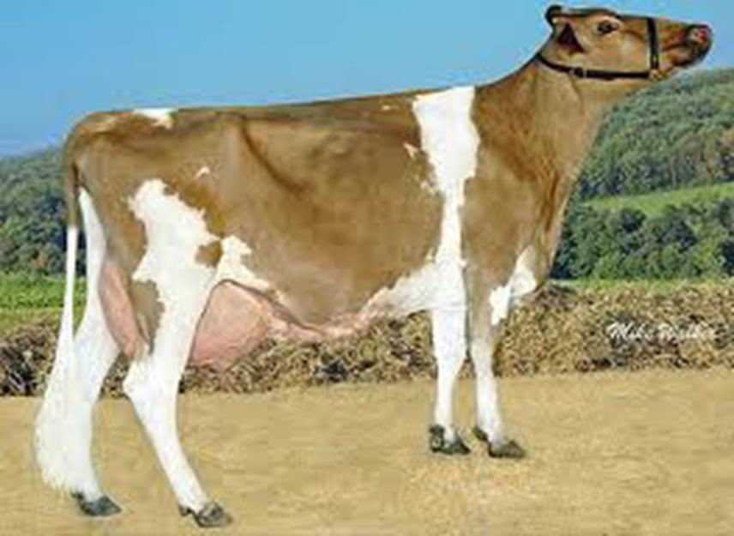
PRACTICE

Slide 10
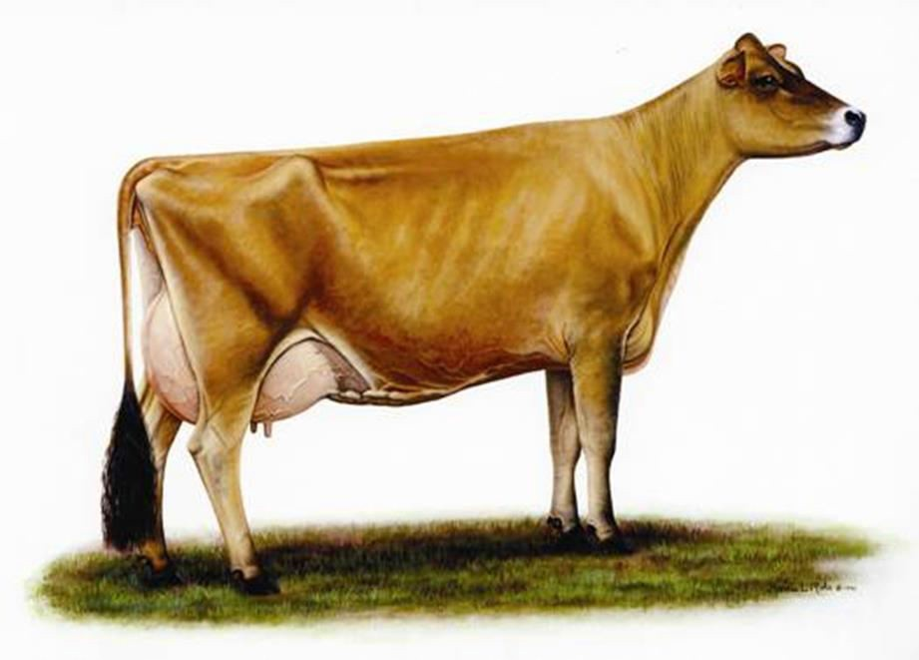
PRACTICE

Slide 11
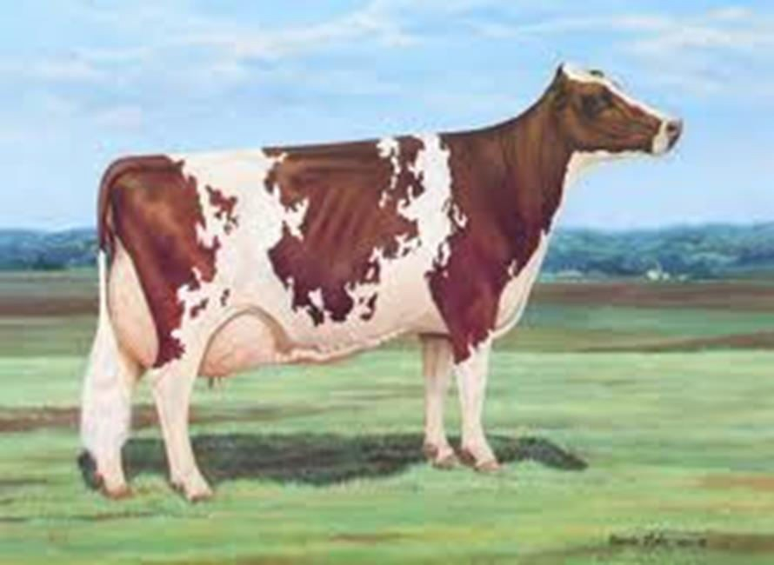
PRACTICE

