Slide 1
VET SCIENCE
Beef Cattle Breeds

Slide 2
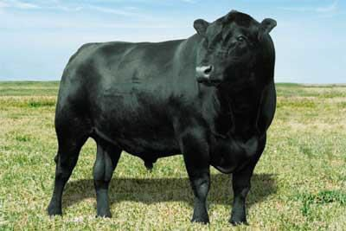
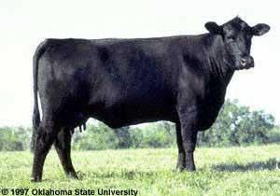
ANGUS
Originated in Scotland
Appearance
Black
Smooth hair coat
Polled
Noteworthy Characteristics
Great in the feedlot
Known for Carcass characteristics (Marbling)

Slide 3
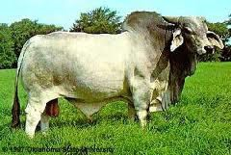
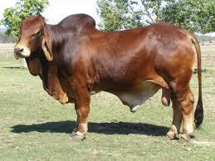
BRAHMAN
Very Hardy, heat and
disease resistance.
Colors are Light gray to
red and almost black.
Hump over shoulders
Loose skin and drooping ears.
Can be mean.

Slide 4
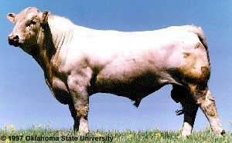
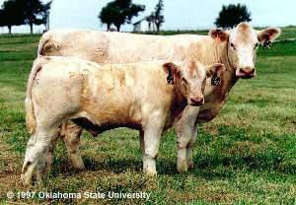
CHAROLAIS
French Breed
Appearance
White to light straw
Pink Skin
Large heavy
muscled breed
Naturally horned but may be polled

Slide 5
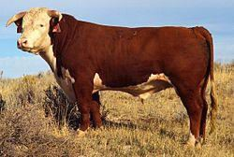
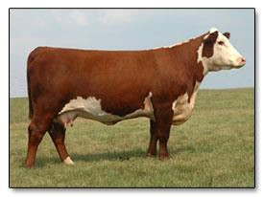
HEREFORD
Originated in England
White faces and red bodies.
White on the belly, legs
and switch.
The breed of the
American West.
Naturally horned but they do have polled varieties.

Slide 6
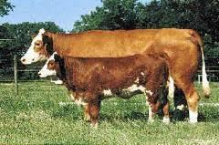
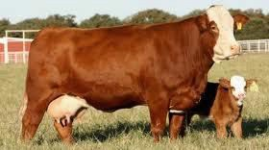
SIMMENTAL
Originated in Switzerland.
White to light straw faces, with red to dark red spotted bodies.
Medium Sized Horns
Large Body
Heavy Muscled and lean carcass.

Slide 7
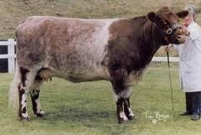
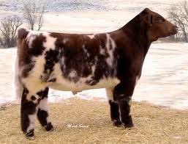
SHORTHORN
Originated in England
Red, White or Roan in color.
Polled or Horned
Very Adaptable to
different climates.
Good Mothers and good Milkers.

Slide 8
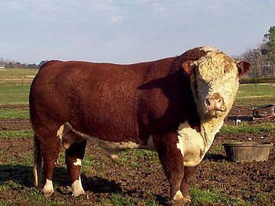
PRACTICE

Slide 9
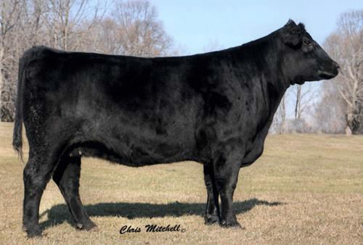
PRACTICE

Slide 10
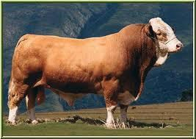
PRACTICE

Slide 11
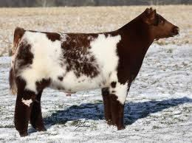
PRACTICE

Slide 12
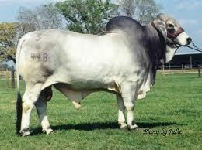
PRACTICE

Slide 13
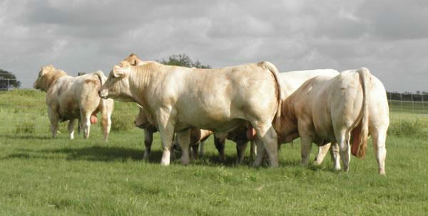
PRACTICE

