Slide 1
Sheep & Goat Breeds
Vet Science

Slide 2
GOATS

Slide 3
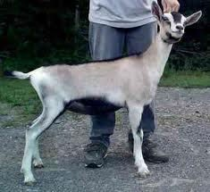
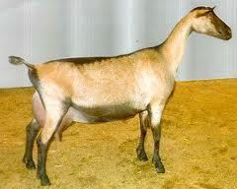
French Alpine
From France
Pure white to black in color.
Short haired with
erect ears.
DIARY GOAT

Slide 4
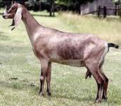
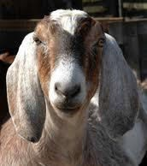
Nubian
From England
Has a long breeding season.
May be any color or combination of colors.
Short hair and long
drooping ears.
Roman noses.
DIARY GOAT

Slide 5
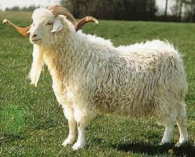
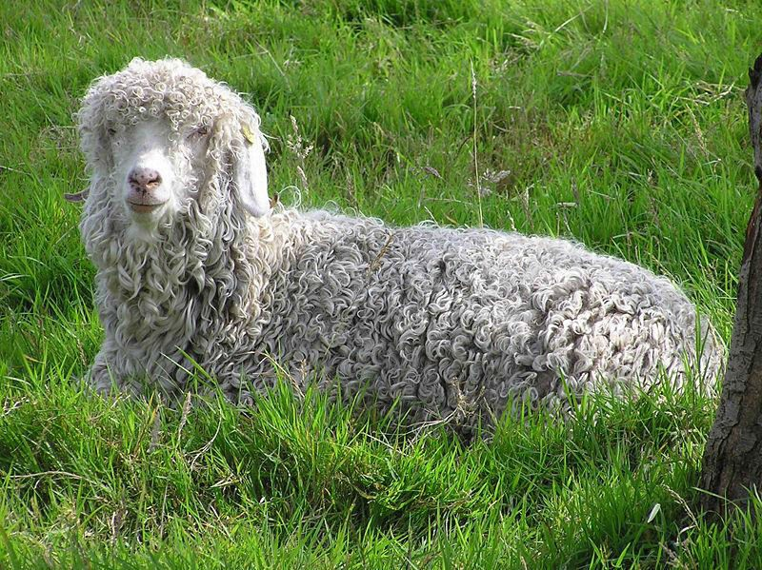
Angora
Produce fleece called
mohair.
Need a high quality diet due to their quick hair growth.
Fragile and not very hardy breed.

Slide 6
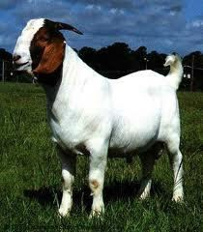
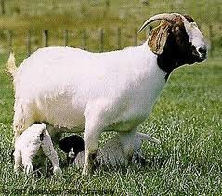
Boer
Developed in South
Africa.
It is a horned breed
with lop ears.
Shows a variety of color patterns , but most have a red head and white body
MEAT GOAT

Slide 7
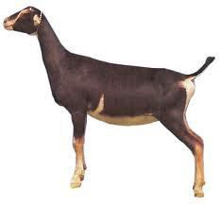
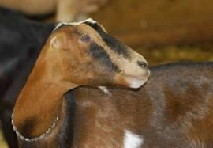
La Mancha
May be any color.
Straight faces with short hair.
They have incredibly short ears 1 inch or less.
DIARY GOAT

Slide 8
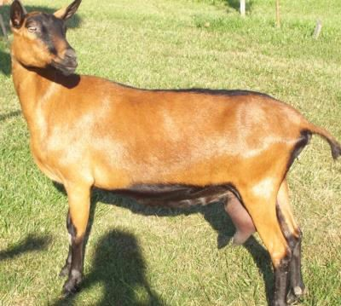
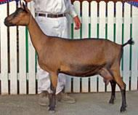
Oberhasli
From Switzerland
Color is a warm reddish brown accented with a black dorsal stripe, legs, belly, and face.
Not as popular in the
United States.

Slide 9
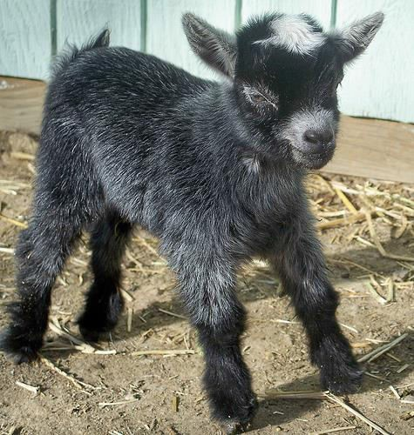
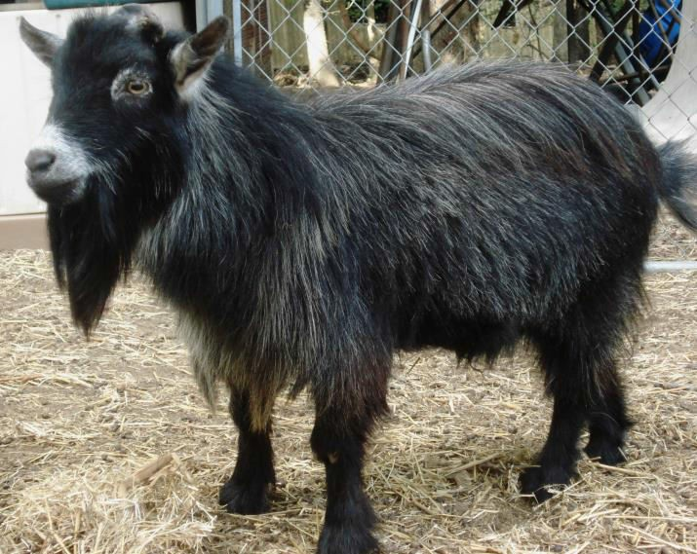
Pygmy
Hardy and friendly
goat.
Mostly kept for pets.
Can be used for milk
and meat.
Small, cobby, and compact body type.

Slide 10
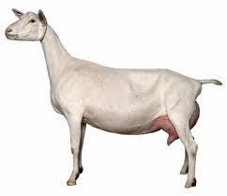
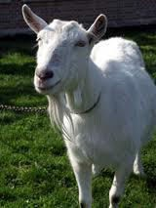
Saanen
From Switzerland
White or light cream in color.
Short hair, but may have fringe over the spine.
Ears are erect.
Both bucks and does are bearded.
DIARY GOAT

Slide 11
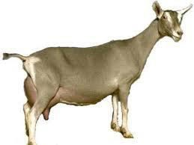
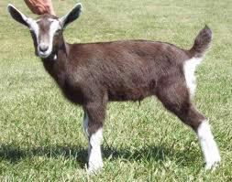
Toggenburg
From Switzerland
Light fawn to dark chocolate in color.
White erect ears with
dark spots.
Two white stripes down the face, and white rump and legs.
DIARY GOAT

Slide 12
Sheep

Slide 13
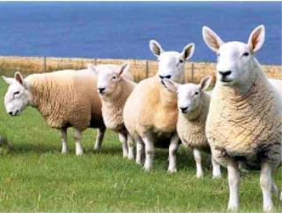
Cheviot
From Northern England and Southern Scotland.
Small with a blocky body type
White face and legs with
black nostrils
Carries head high and appears alert.
Does not have a strong flocking instinct.

Slide 14
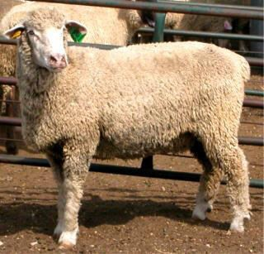
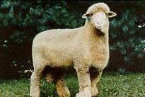
Columbia
Large framed sheep
developed in the U.S.
Hornless breed
White wool, legs, and
faces.
Roman nose.

Slide 15
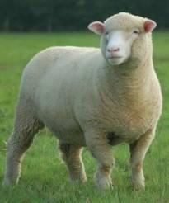
Dorset
Southern England
Medium sized with blocky body type.
Ears, nose, face and legs
are white.
There are polled and horned strains.
Produce a medium to
course light fleece.
Muscular carcass

Slide 16
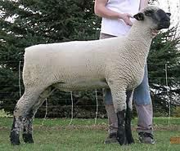
Hampshire
Southern England
Large in size with a blocky body.
Face, legs, ears, and nose are black. With light wool on legs and top of head.
Polled
One of the most popular medium wools breeds in the U.S. also good for meat.

Slide 17
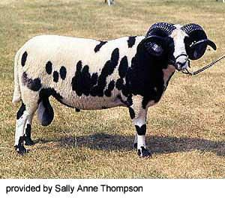
Jacob
Rare breed of multi
horned sheep.
  Can have two to 6
horns.
Colored with white spots.
Raised for wool, meat, hides, and as specialty pets.

Slide 18
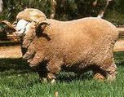
Merino
Spain
FINE WOOL BREED
  Three Types A,B, & C
Type C is the Delaine Merino is popular in the U.S.
Rams are horned
Long, and uniform fleece used in production of wool.

Slide 19
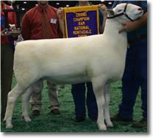
Montadale
Originated in the U.S.
  Cross between a Cheviot and a Columbia
Medium to large breed with a
blocky body.
The face, ears, and legs are white.
No wool on face or legs
Polled
Good Meat Carcass

Slide 20
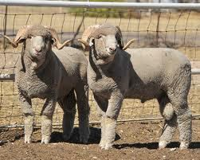
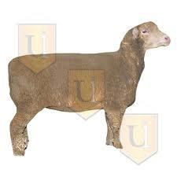
Rambouillet
France
FINE WOOL BREED
White large breed, with
an angular body.
Rams have horns, Ewes are polled.
Produces wool, and better meat than the Merino.

Slide 21
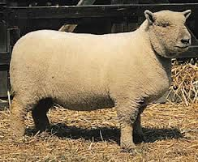
Southdown
Southern England
One of the oldest sheep breeds in the world.
Face, legs, and ears are gray or mouse brown, and wooly.
Small blocky and low set
body.
Get fat easy

Slide 22
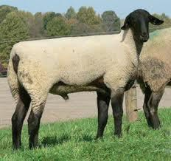
Suffolk
Southern England
Large Framed with a blocky, muscular body.
Face, legs, and ears are black and have no wool on them.
Large Bell Shaped Ears
Produce lean, muscular carcasses.

Slide 23
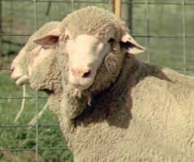
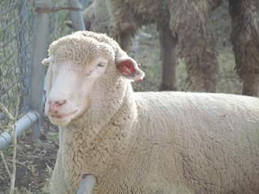
Practice

Slide 24
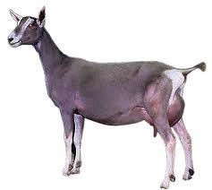
Practice

Slide 25
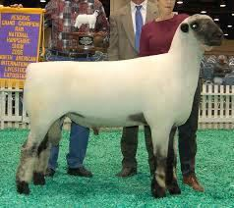
Practice

Slide 26
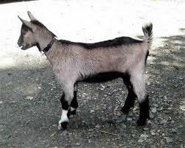
Practice

Slide 27
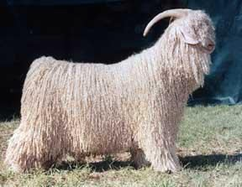
Practice

Slide 28
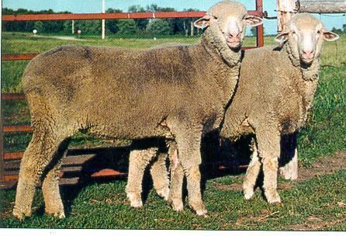
Practice

Slide 29
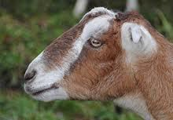
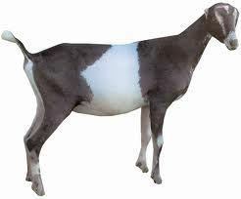
Practice

Slide 30
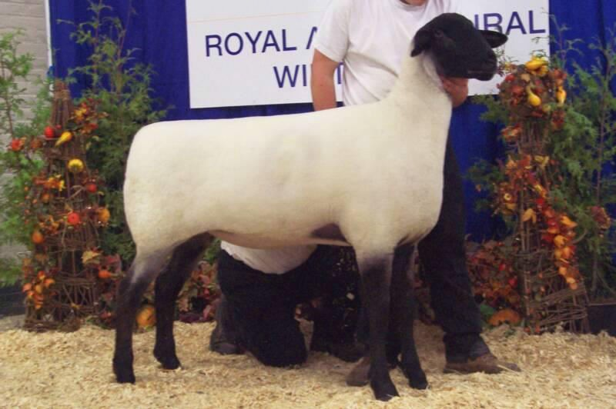
Practice

Slide 31
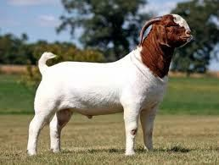
Practice

Slide 32
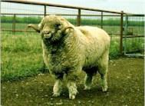
Practice

Slide 33
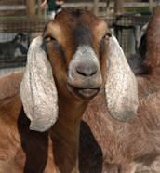
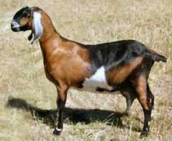
Practice

Slide 34
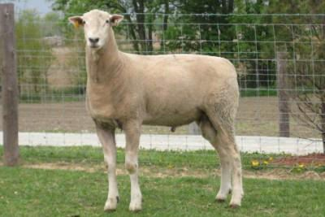
Practice

Slide 35
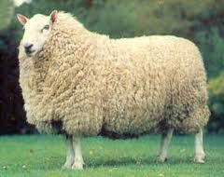
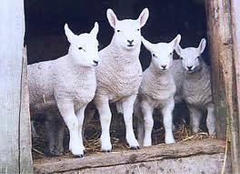
Practice

Slide 36
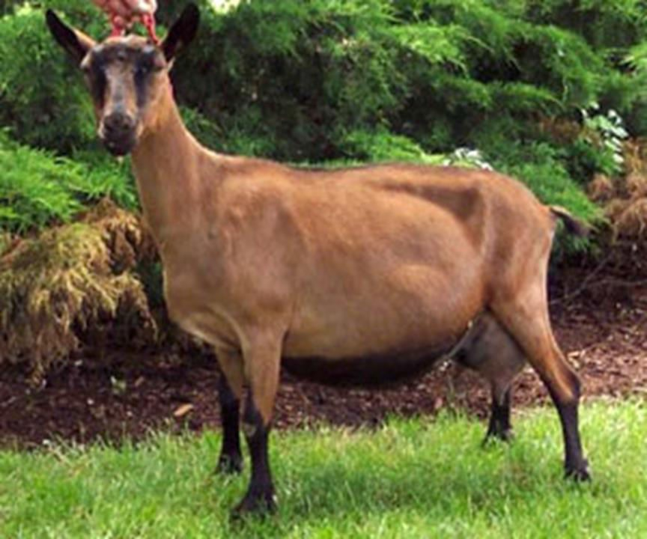
Practice

Slide 37
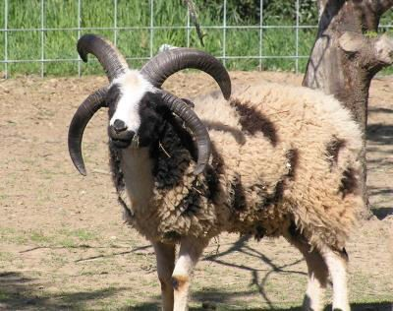
Practice

Slide 38
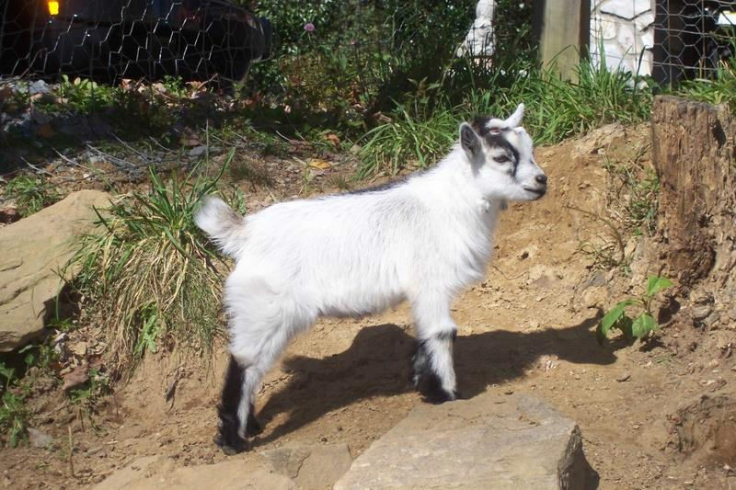
Practice

Slide 39


Practice

Slide 40

Practice

Slide 41

Practice

