Slide 1



Vet Science

Slide 2
Swine

Slide 3
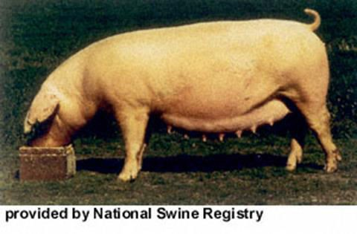
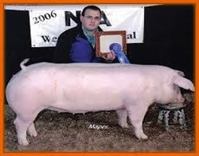
Large Drooped
ears
Known for their
maternal instincts
White
Long Bodied
Flatter-topped than other breeds

Slide 4
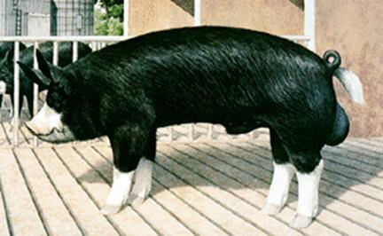

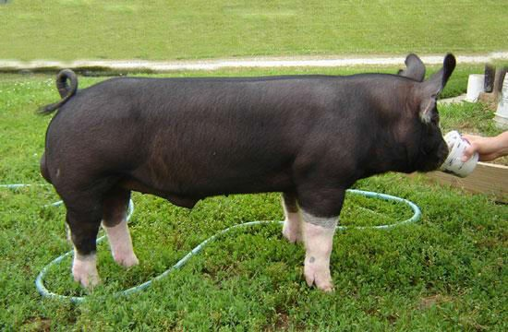
Originated in
England
Black with white legs, snout and switch
Once kept at
Buckingham Palace
Known for producing high quality meats
Erect ears

Slide 5
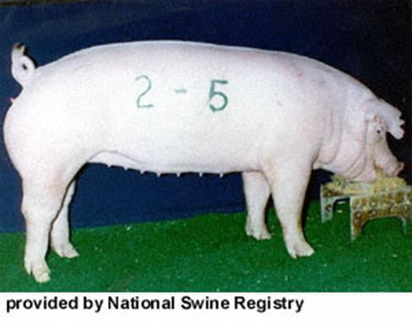
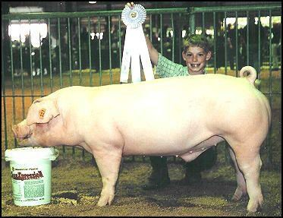
Originated in Chester County, Pennsylvania
White with
drooped ears
Mothering breed
Known to produce large litters

Slide 6
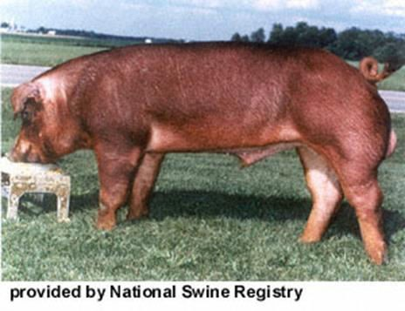

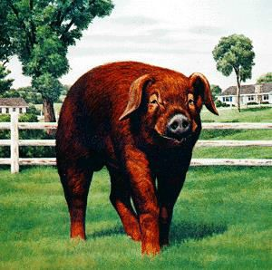
Originated in the
United States
Solid red or
reddish brown.
Drooped ears
Slight dish to the face
Excellent meat
type hog

Slide 7

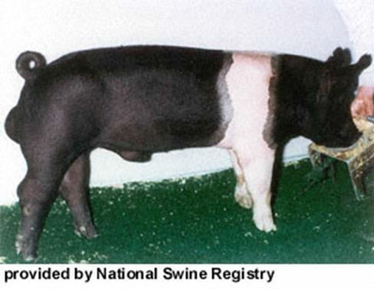
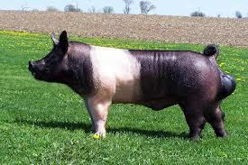
Probably the oldest American breed
Black with a white
belt
Small, erect ears
Well-known meat breed

Slide 8

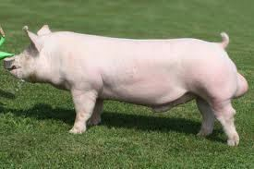
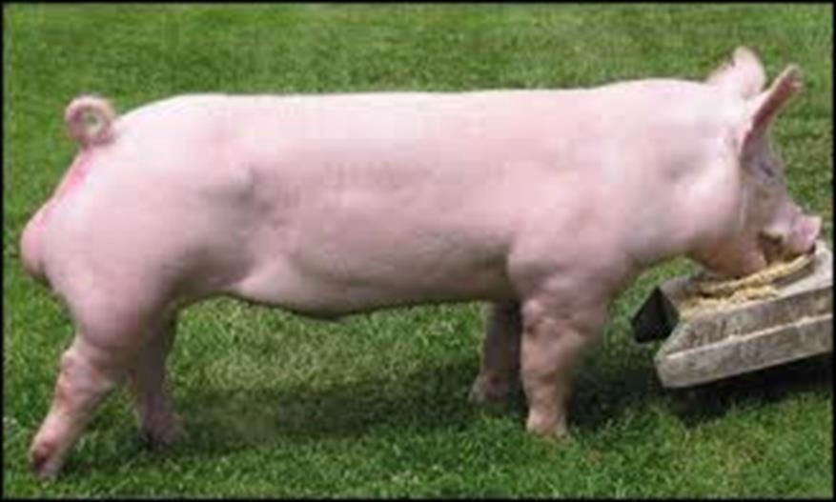
Originated in
England.
White pig with
erect ears.
Have large litters, and are good mothers.
Rapid growing and
long bodied.

Slide 9
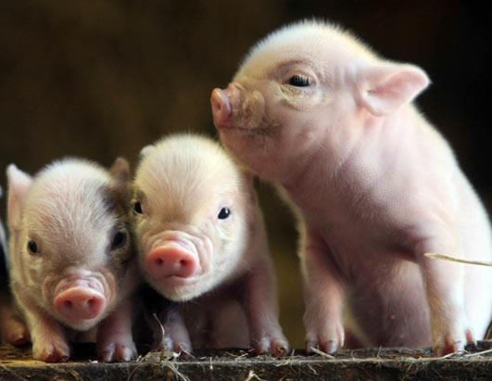

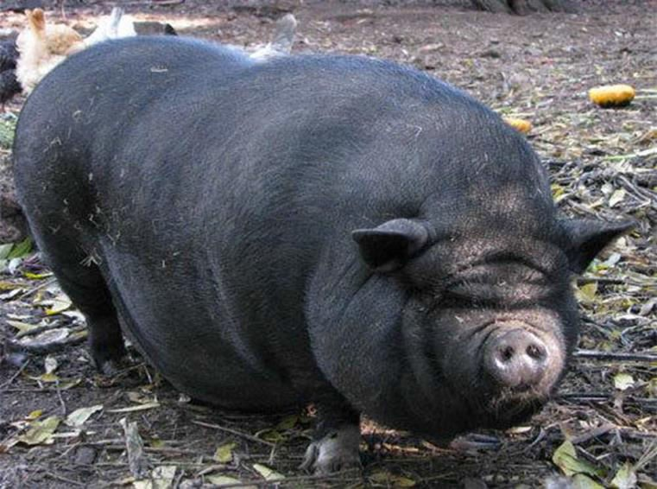
Smaller than an
average pig.
Originated in
Vietnam.
Will grow into a “pig” do not stay small and cute.
Popular “Fad” Pet
  Many are abandoned after they reach mature size.

Slide 10
Poultry

Slide 11
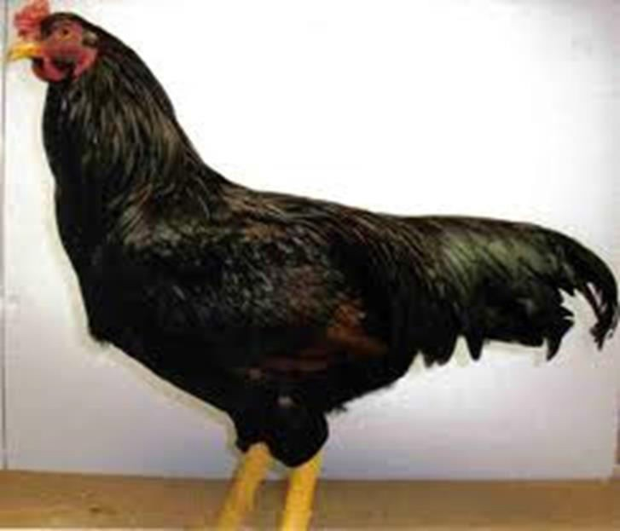
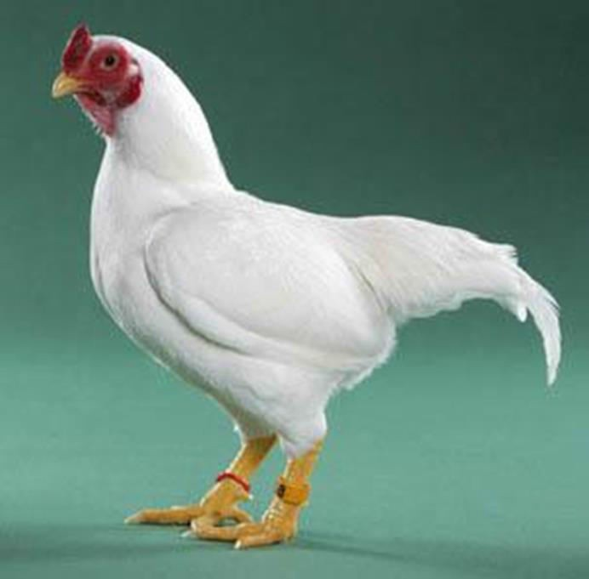
Muscular Bird used for meat production
Large Stocky bird
Big wide spaced legs.
Lays brown eggs

Slide 12
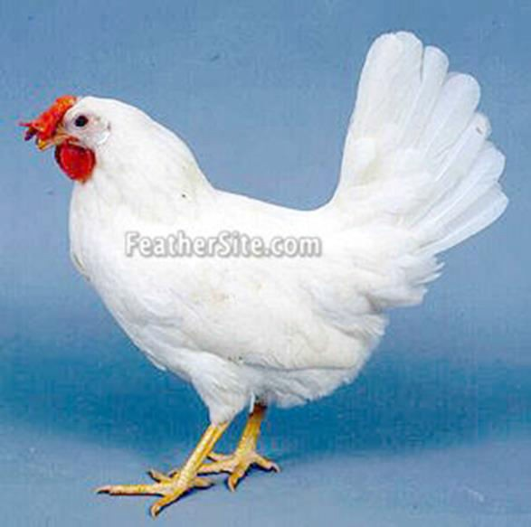
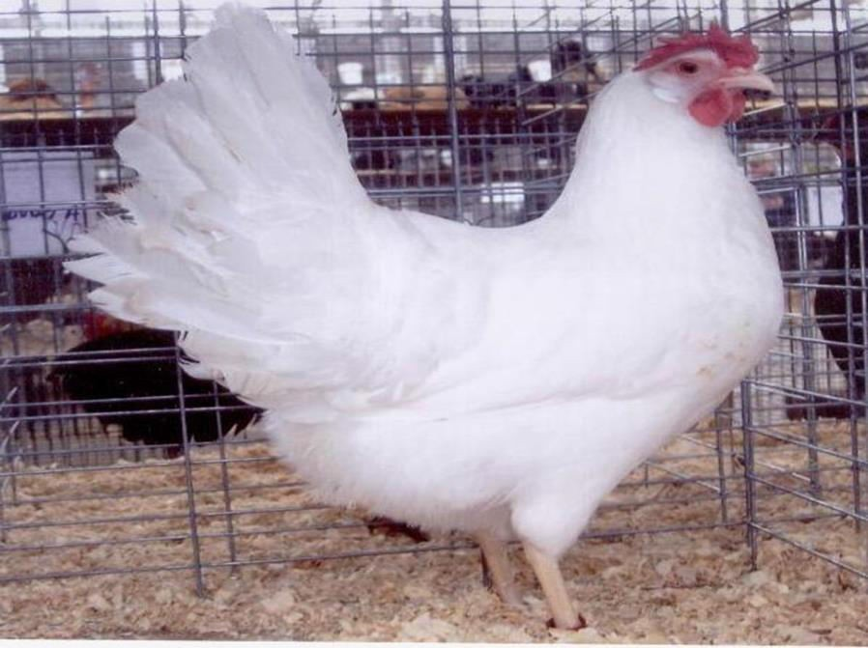
Excellent layers
Originated from Italy
3 lbs to 4 lbs (Small)
Used in commercial egg production
White Eggs
Yellow Skin
Single Comb
White Earlobes

Slide 13
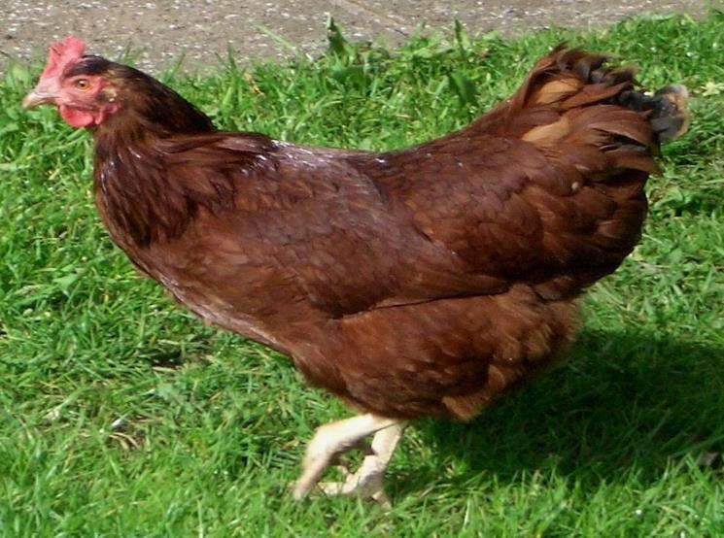
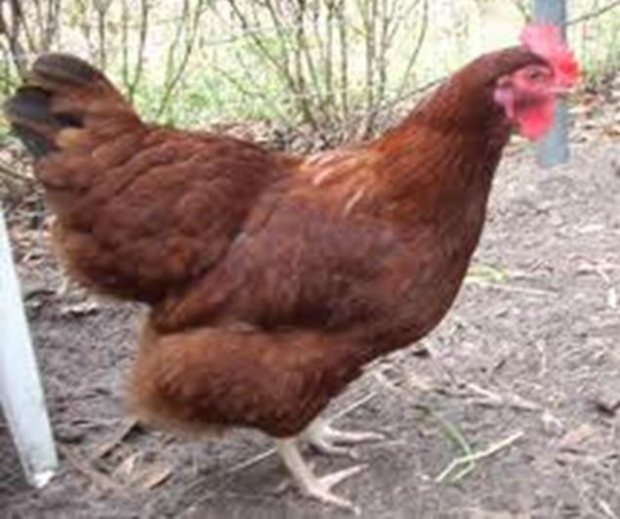
Popular dual
purpose chicken.
Used for Meat and
Eggs
  Lays Large Brown Eggs.
Hardy Chicken
Rust colored to dark maroon colored feathers.
Yellow Feet

Slide 14
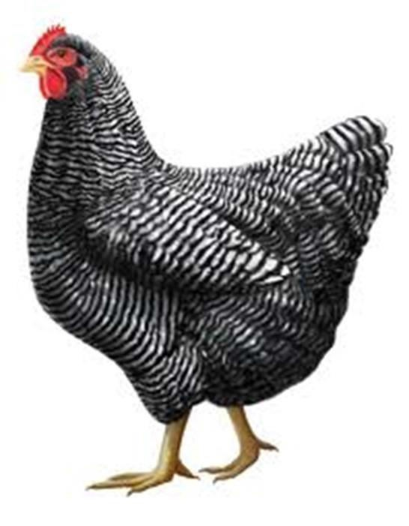
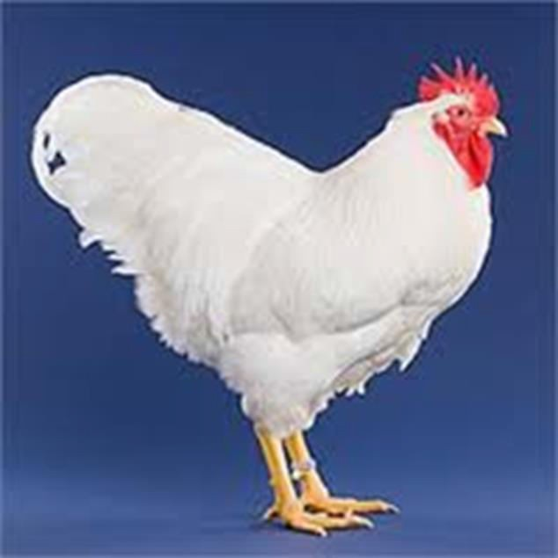
Dual Purpose
Good for eggs and Meat
Brown Eggs
Yellow Skin
Red Earlobes
Comes in multiple colors.
  White
  Barred
  Buff
  Black
  And more…

Slide 15
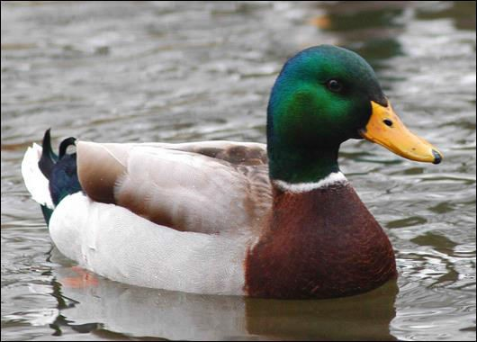

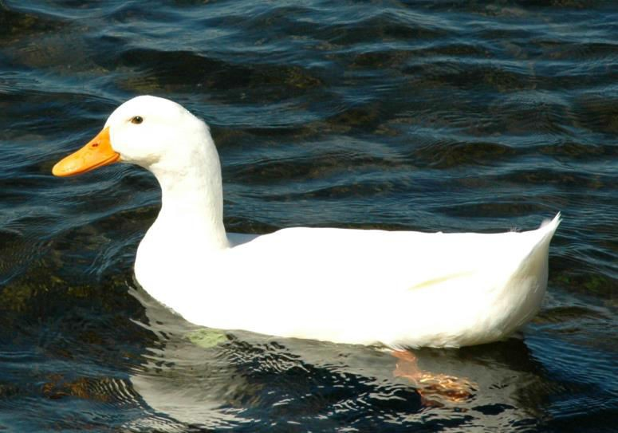
Mostly aquatic
Have elongated bodies and necks.
One of the most numerous birds in North America.
There are about 28 types in the U.S.

Slide 16
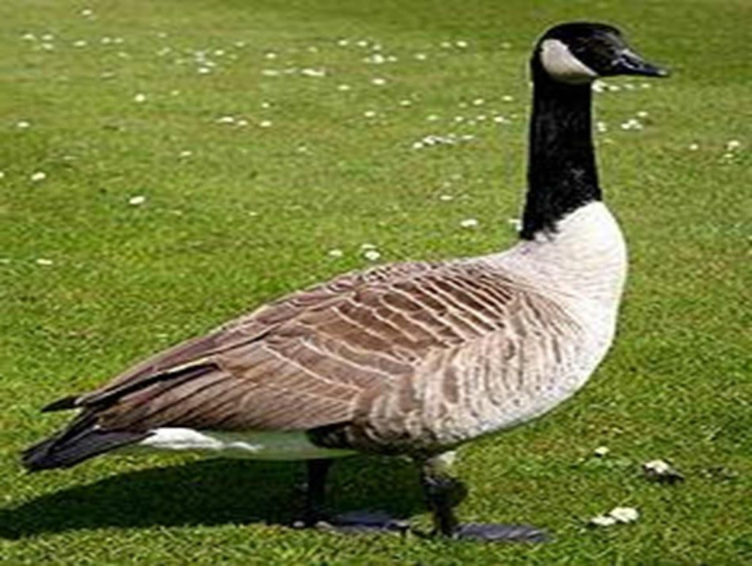

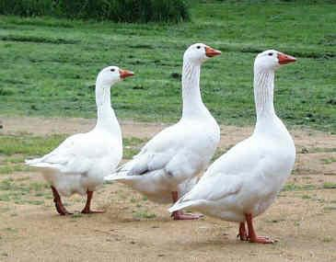
Waterfowl
Have long necks
Kept for meat, eggs, or feathers for down.
Their eggs are larger and denser than chicken eggs but have a similar flavor.

Slide 17
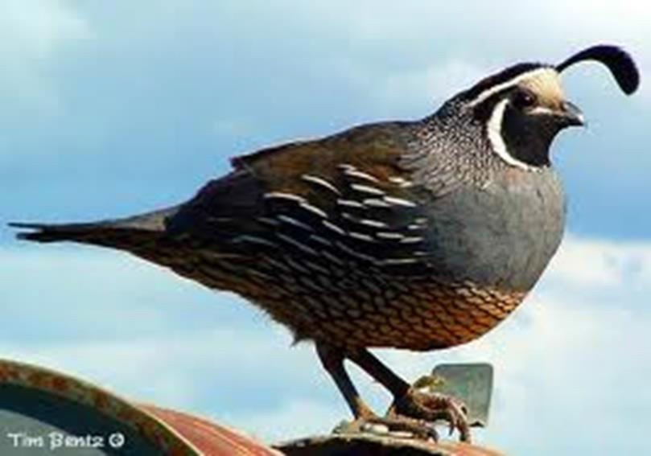

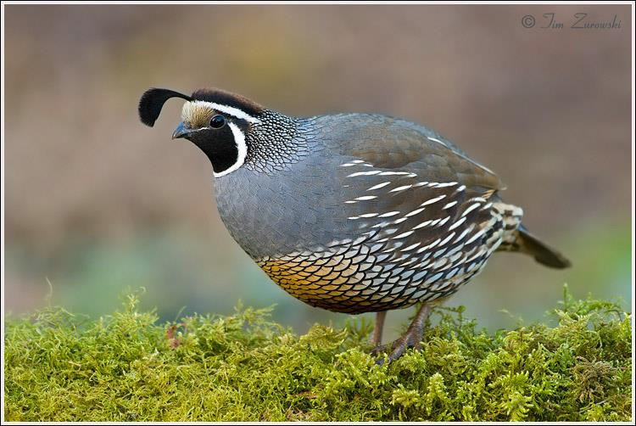
Raised for pets, feathers, eggs, or game hunting (Meat.)
Small plump and round bird.
Have a curved black crown feather.

Slide 18
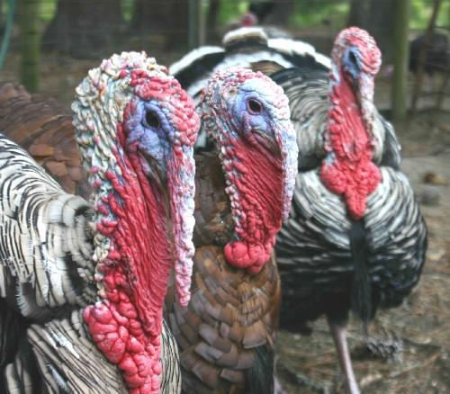

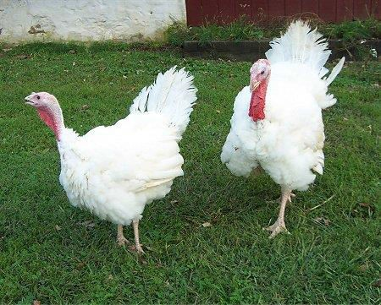
Large birds used for meat and feathers.
Males have a wattle that hangs from the top of their beak.
Both wild and domestic turkeys.

Slide 19

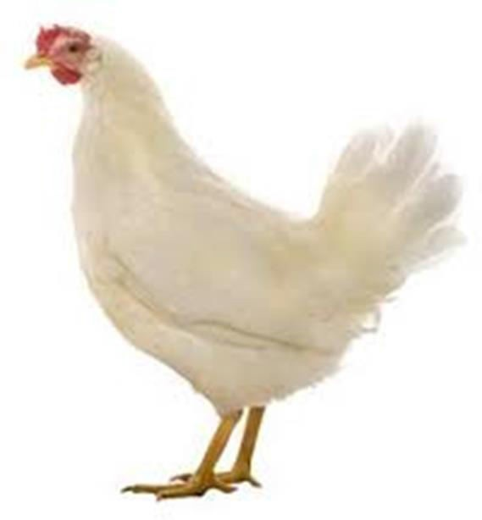

Slide 20
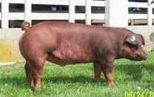

Slide 21
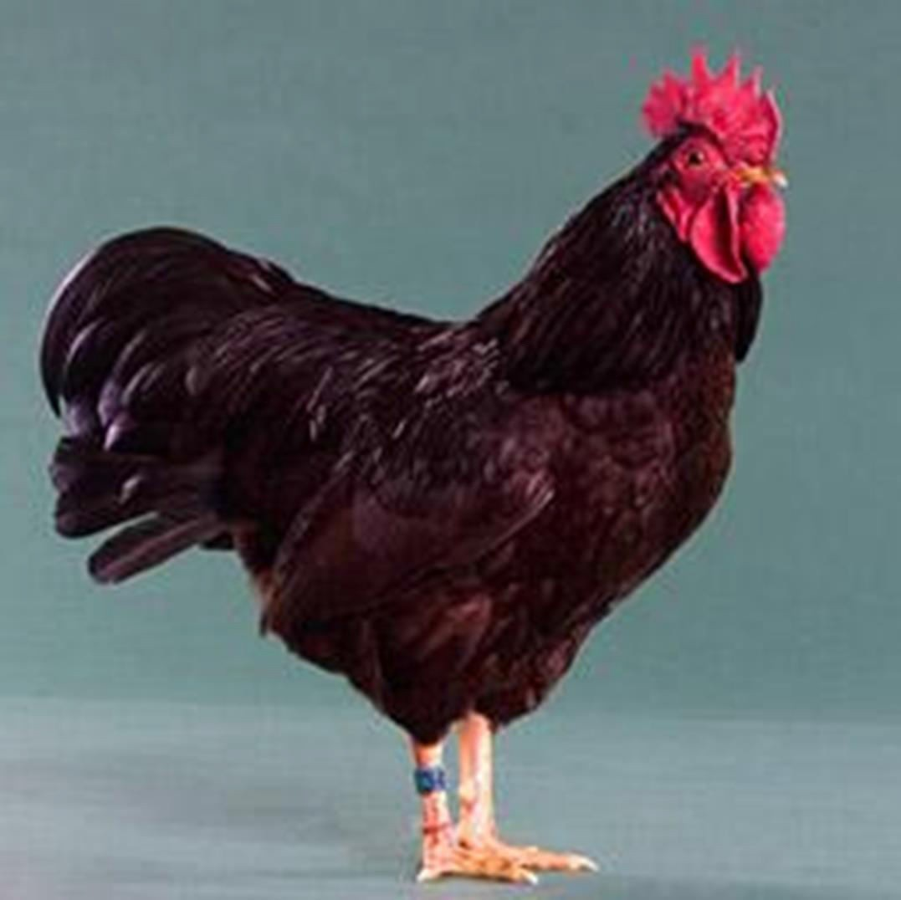

Slide 22

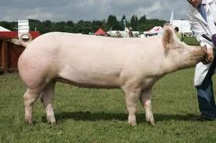

Slide 23
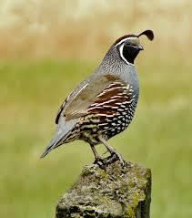

Slide 24
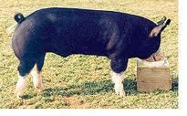

Slide 25
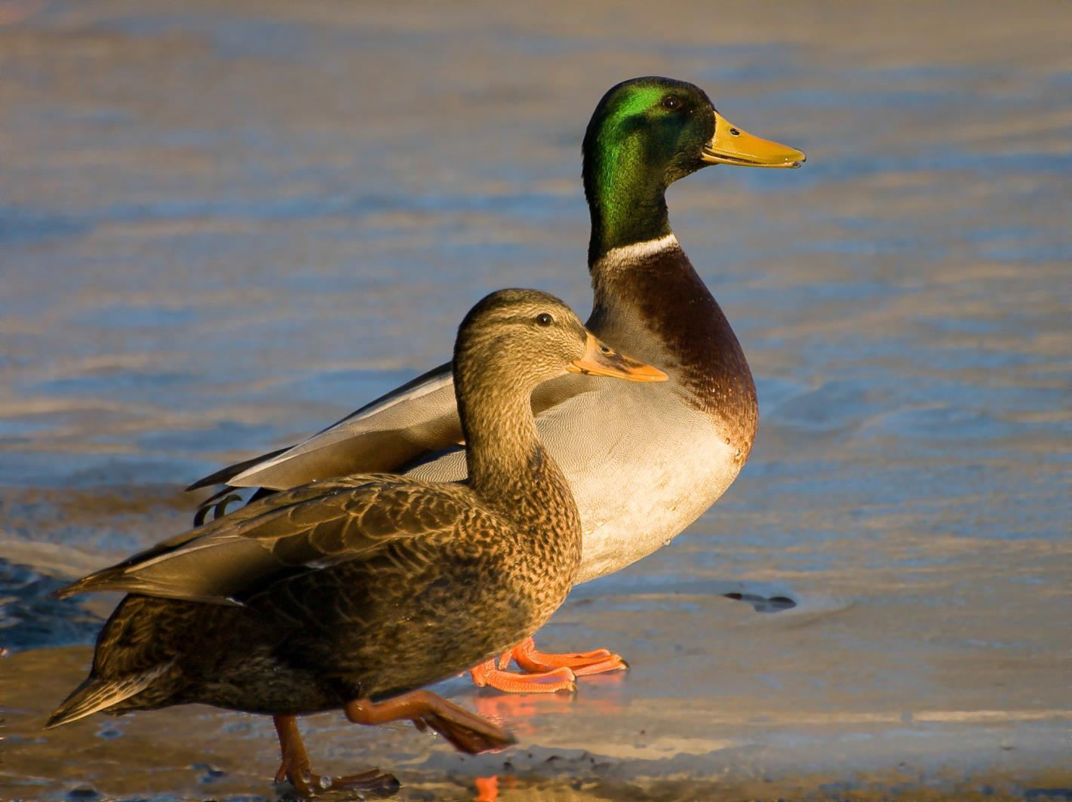

Slide 26
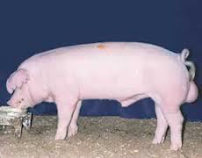

Slide 27
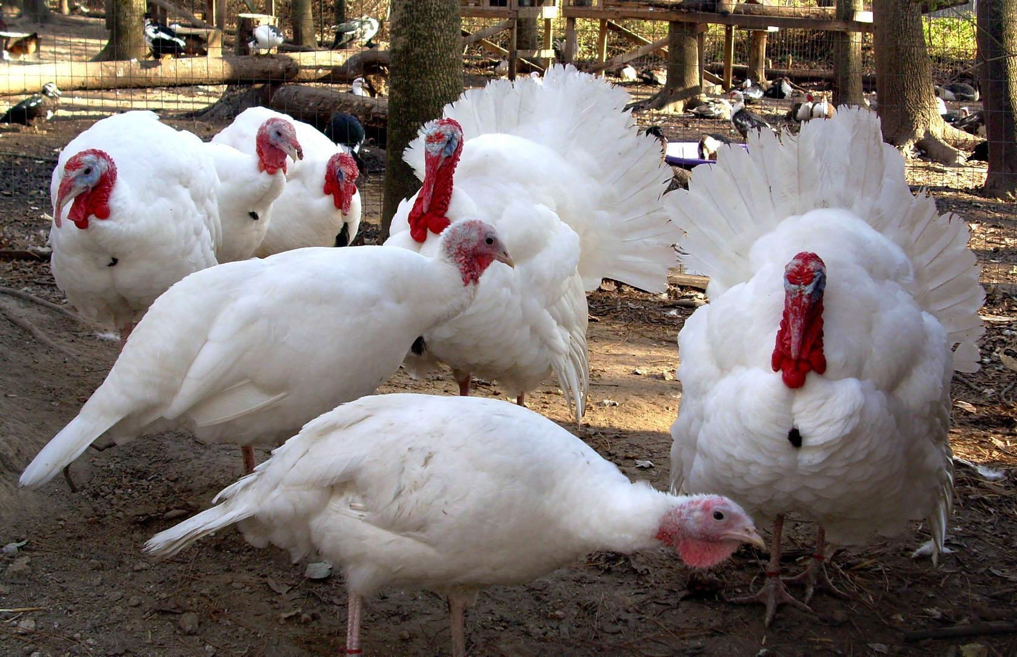

Slide 28
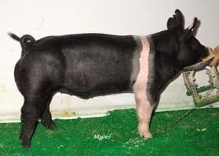

Slide 29
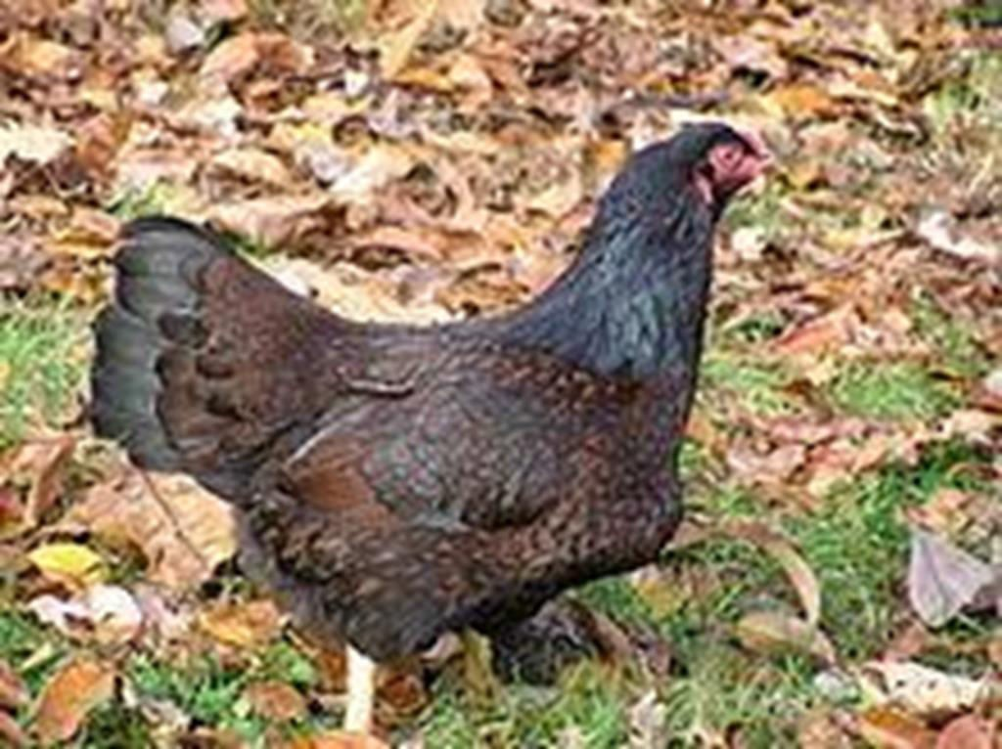

Slide 30
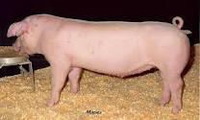

Slide 31
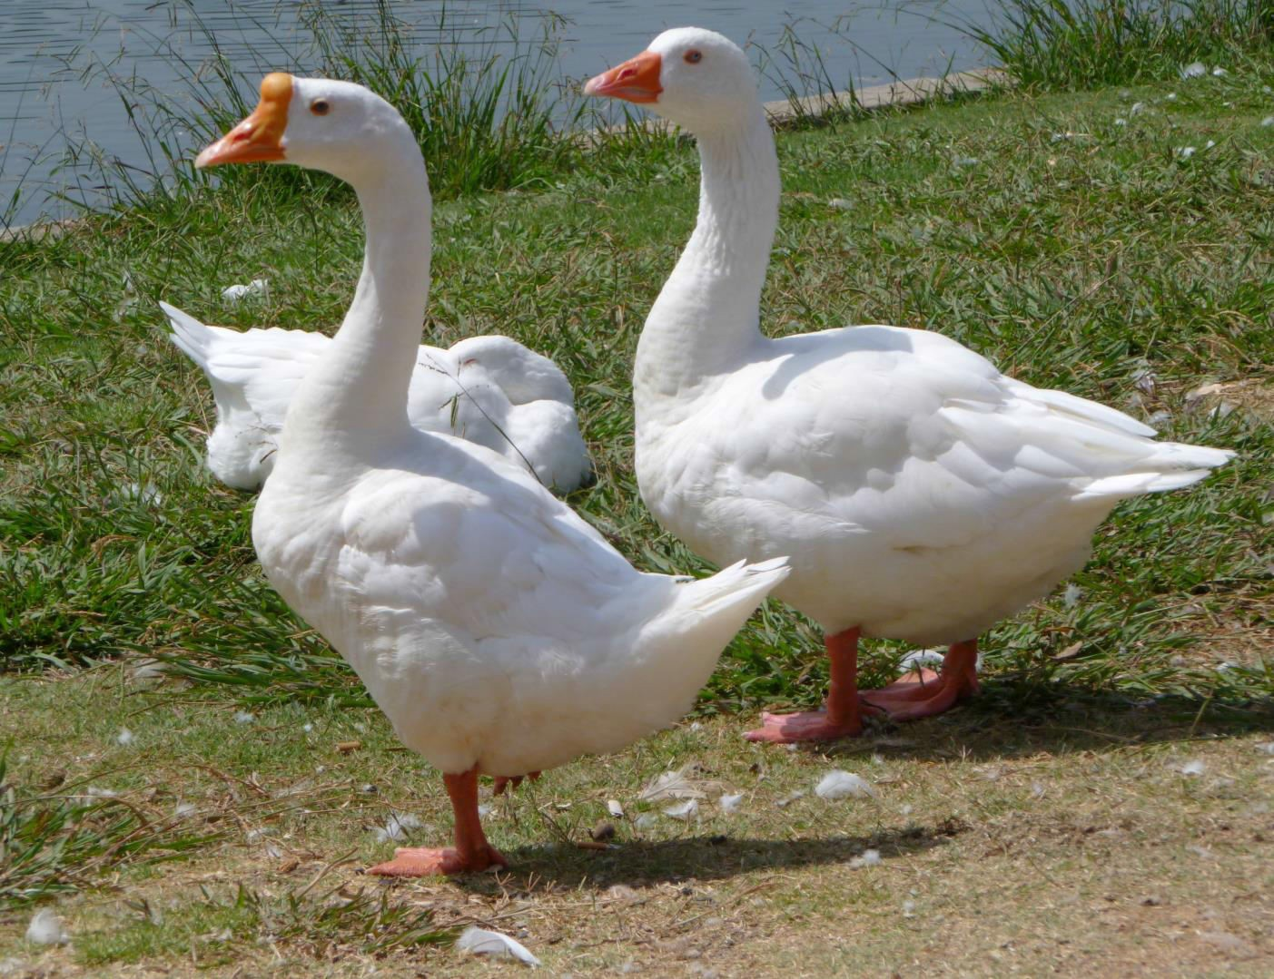

Slide 32
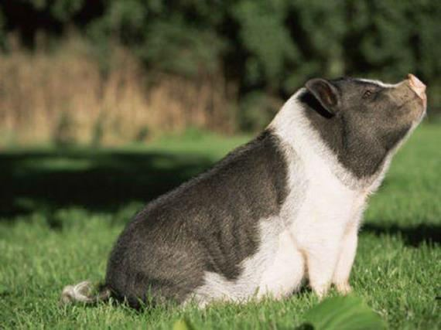
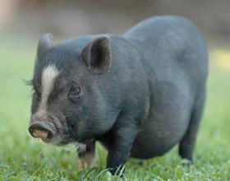

Slide 33
