Slide 1
Weekly Animal ID
SPORTING and HOUND GROUPS

Slide 2
SPORTING GROUP

Slide 3
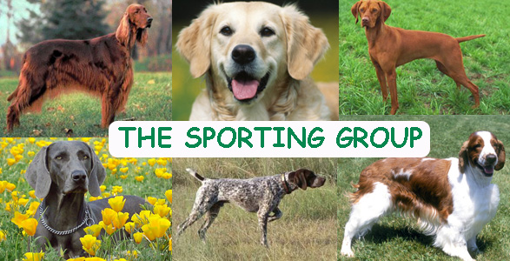
Sporting
Number of Breeds: 30
Examples of Breeds: Pointers, retrievers, setters, spaniels
Characteristics: bred for hunting
Handling notes: cooperative, trainable, human focused, rambunctious

Slide 4
From Germany
Versatile and can be used to hunt all types of game.
Rustic Looking
Outstanding
temperament
Tails usually docked to
40%
The German Shorthaired
Pointer
Height: 23–25 inches
Weight: 55–70 lbs

Slide 5
Native to Canada
Strong and active
breed
Great in water related hunting, loves to swim.
Friendly and good natured.
Colors: Black,
chocolate, or yellow.
HEIGHT | MIN | MAX | WEIGHT | MIN | MAX
Female | 21" | 22" | Female | 55 lbs. | 70 lbs.
Male | 23" | 24" | Male | 65 lbs. | 85 lbs.
Labrador Retriever

Slide 6
Trained as a bird dog
Gained popularity in the U.S. due to its usefulness and beauty.
Mild and sweet
disposition.
HEIGHT | MIN | MAX | WEIGHT | MIN | MAX
Female | 24" | 25.5" | Female | 55 lbs. | 66 lbs.
Male | 25.5" | 26.5" | Male | 55 lbs. | 66 lbs.
The English Setter

Slide 7
Solid Red Breed
Hunts all types of game, fast and tough in all types of terrain.
Independent and Bold
Gentle, loveable, and
loyal.
HEIGHT | MIN | MAX | WEIGHT | MIN | MAX
Female | 24" | 25" | Female | 59 lbs. | 67 lbs.
Male | 25" | 26" | Male | 59 lbs. | 67 lbs.
The Irish Setter

Slide 8
Developed in the Scottish Highlands
Intelligent and eager to please attitude.
One of the most popular breeds in the U.S.
Good hunting dog, research and rescue dog.
HEIGHT | MIN | MAX | WEIGHT | MIN | MAX
Female | 22" | 24" | Female | 60 lbs. | 70 lbs.
Male | 22" | 24" | Male | 66 lbs. | 75 lbs.
Golden Retriever

Slide 9
Has style and enthusiasm.
Eager to please attitude
Can keep going even in
tough hunting conditions.
Medium sized powerful body.
Long, hanging ears moderately long coat that can be black or liver with white, blue or liver roan, and tricolor.
English Springer
Weight: 45–55 lbs Height: 19–22 inches
Spaniel

Slide 10
Smallest member of the
sporting family
Gets its name for its ability to hunt woodcock.
Cheerful, hardy, and
elegant.
Excellent family dog
Sensitive
American Cocker
HEIGHT | MIN | MAX | WEIGHT | MIN | MAX
Female | 13" | 14.5" | Female | 22 lbs. | 28 lbs.
Male | 14" | 15" | Male | 22 lbs. | 28 lbs.
Spaniel

Slide 11
Referred to as the grey ghost because of its short sleek coat.
Graceful dog with aristocratic features
Built for Speed, has strong courage and sensing ability.
Height: 24–26 inches
Weight: 66–88 lbs
Weimaraner

Slide 12
Medium sized dog
Good for hunting or companionship.
Originated in the French province of Brittany.
Hunting style resembles
that of the pointer.
Its dense, flat or wavy coat can be orange and white or liver and white in either clear or roan patterns.
The Brittany
Height: 19–20 inches
Weight: 30–40 lbs

Slide 13
Gets its names from
the stance taken in the
presence of game.
From England
Powerful and agile
Even temperament, compassionate, and intelligent.
The Pointer
HEIGHT | MIN | MAX | WEIGHT | MIN | MAX
Female | 24" | 26" | Female | 57 lbs. | 57 lbs.
Male | 25" | 27" | Male | 66 lbs. | 66 lbs.

Slide 14
HOUND GROUP

Slide 15
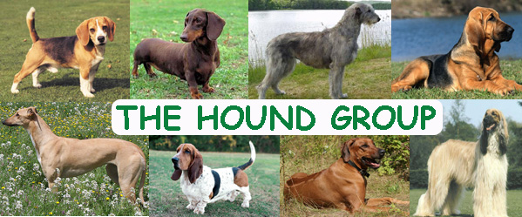
Hound
Number of Breeds: 23
Examples of Breeds: Basset, Beagle, Bloodhound, Greyhound
Characteristics: Bred for hunting, strong scent abilities
Handling Notes: good stamina, vocal, independent, difficult to train, generally friendly and affectionate

Slide 16
Big Heavy body and short legs.
Can chase scents for
long distances.
Can hunt alone or in
packs.
Sweet and Gentle natured.
HEIGHT | MIN | MAX | WEIGHT | MIN | MAX
Female | 13" | 15" | Female | 40 lbs. | 60 lbs.
Male | 13" | 15" | Male | 40 lbs. | 60 lbs.
Bassett Hound

Slide 17
Hunting ability and great personality make this one of the most popular dogs in the U.S.
Compact size and happy-go-lucky personality make them good family pets.
HEIGHT | MIN | MAX | WEIGHT | MIN | MAX
Female | 13" | 16" | Female | 17 lbs. | 31 lbs.
Male | 13" | 16" | Male | 17 lbs. | 31 lbs.
Beagle

Slide 18
Described as a "unique looking dog in a baggy suit,"
Are affectionate but can be shy.
Strong sent tracker
Large Dog
Weight: 90–110 lbs
Height: 25–27 inches)
Bloodhound

Slide 19
The Dachshund, meaning "badger dog" in German, is a lively breed with a friendly personality and keen sense of smell.
They come in three different coat varieties (Smooth, Wirehaired or Longhaired) and can be miniature or standard size
HEIGHT | MIN | MAX | WEIGHT | MIN | MAX
Female | 4" | 7" | Female | 9 lbs. | 11 lbs.
Male | 4" | 7" | Male | 9 lbs. | 11 lbs.
Dachshund

Slide 20
Tall and lean, the Greyhound is the fastest breed of dog.
They are a loving and passionate dog.
HEIGHT | MIN | MAX | WEIGHT | MIN | MAX
Female | 26.5" | 28" | Female | 59 lbs. | 66 lbs.
Male | 28" | 30" | Male | 66 lbs. | 70.5 lbs.
Greyhound

Slide 21
Persistent, determined, honest hunter who will stay on track no matter the terrain or conditions.
Used to tree raccoon.
Outgoing and friendly
Height: 23 to 27 inches Weight: 75 to 100 pounds
Black and Tan Coonhound

Slide 22
The American Foxhound was bred to run, so they are an ideal pet for those who live in rural areas or on large farms.
Height: 22–25 inches
Weight: Female: 44–64 lbs
American Foxhound

Slide 23
Elegant hunting dog from Africa.
Smoothly muscular and
agile.
Wrinkled face, upright ears, and tightly curled tail.
When it does bark it is said
to sound like a yodel.
Colors include chestnut red, pure black or brindle -- all with white feet, chest and tail tip.
Height: 16–17 inches Weight: 22–26 lbs
Basenji

Slide 24
Referred to as an
aristocrat.
Has thick silky hair
Very popular as a show dog.
Height:22 - 26 inches tall Weight:50 to 60 pounds
Afghan Hound

Slide 25
Denotes great speed, power and balance.
Is an English
Greyhound in miniature
The fastest domesticated animal of his weight, capable of speeds up to 35 m.p.h
Weight: 15 – 31 lbs
Height:19–22 inches
Whippet

Slide 26
PRACTICE

Slide 27
Practice

Slide 28
Practice

Slide 29
PRACTICE

Slide 30
PRACTICE

Slide 31
Practice

Slide 32
Practice

Slide 33
PRACTICE

Slide 34
PRACTICE

Slide 35
Practice

Slide 36
Practice

Slide 37
PRACTICE

Slide 38
Practice

Slide 39
Practice

Slide 40
Practice

Slide 41
PRACTICE

Slide 42
PRACTICE

Slide 43
Practice

Slide 44
PRACTICE

Slide 45
PRACTICE

Slide 46
PRACTICE

