Slide 1
WORKING GROUP
Dogs

Slide 2
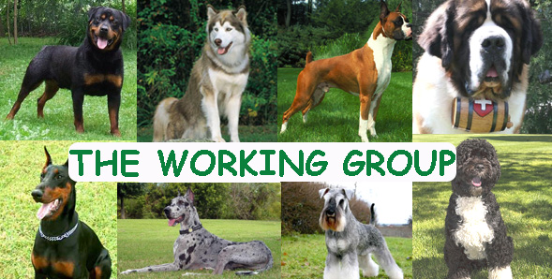
Working
Number of Breeds: 26
Examples of Breeds: Boxer, Great Dane, Siberian Husky, Saint Bernard
Characteristics: Bred for specific jobs, carting, rescue or protection, large
Handling Notes: Intelligent, very trainable, prefer humans, destructive when not given a “job”

Slide 3
Large, powerful and alert, a working breed that originated in Japan
Thick double coat can be any color including white, brindle or pinto.
An Akita trademark is the plush tail that curls over his back.
Can be aggressive and should be supervised with children.
Height: 24-28 “
Weight: 70- 130 pounds
Akita

Slide 4
The largest and oldest of the Arctic sled dogs, the Alaskan Malamute possesses great strength and endurance
Affectionate and friendly family dog.
Highly intelligent and learns quickly, but can also be strong- willed.
Height: 22-26”
Weight: 70-95 Pounds
Alaskan Malamute

Slide 5
Asian sled dog, the Siberian Husky is known for its amazing endurance and willingness to work.
All colors from black to pure white are allowed, and a variety of markings on the head is common.
Agreeable and outgoing temperament.
Height: 20-24”
Weight: 35-60 pounds
Siberian Husky

Slide 7
Intelligent, strong and agile.
Mountain Farm Dog
Like the other Swiss breeds, they are tri- colored, with patches of black, rust and white.
Gentle and easygoing, good family dog.
Height: 23-28”
Weight: 80-110 pounds
Bernese Mountain Dog

Slide 8
Athletic, and powerful dog with an intelligent and alert expression.
Great guard dogs, but also loves human companionship.
One of the most popular dogs in the U.S.
Fawn to brindle in color.
Height: 21-25”
Weight: 55-71 pounds
Boxer

Slide 9
Strong and powerfully built large dog.
Possesses great intelligence and a willingness to please, making them ideal family companions and protectors.
Height: 24-27”
Weight: 100-130 poiunds
Bullmastiff

Slide 10
Very large English guard dog.
The Mastiff is a powerful yet gentle and loyal companion, but because of his size and need for space, he is best suited for country or suburban life.
Height: 28-36”
Weight: 120-230 pounds
Mastiff

Slide 11
A square, medium- sized dog, the Doberman Pinscher is muscular and possesses great endurance and speed.
He is elegant in appearance and reflects great nobility and temperament.
Watchful and fearless, great guard dog.
Height: 24-28”
Weight: 60-100 pounds
Doberman Pinscher

Slide 12
A larger and more powerful version of the Standard Schnauzer.
An active and spirited dog, with a reliable temperament.
Solid black or salt and pepper, with eyebrows and a beard.
Height: 23-28”
Weight: 55-105 Pounds
Giant Schnauzer

Slide 14
A medium-sized working breed, the Standard Schnauzer is sturdy and athletic, known for his arched eyebrows and bristly mustache and whiskers, the hallmark of the breed
Smaller than the giant schnauzer.
Height: 18-20”
Weight: 31-44 Pounds
Standard Schnauzer

Slide 15
A "gentle giant," the Great Dane is nothing short of majestic.
Excellent family dogs.
Coat colors can be brindle, fawn, blue, black, harlequin and mantle.
Height: 28-34”
Weight: 100-200 pounds
Great Dane

Slide 16
Intelligent, great sight and sense of smell.
Used to guard flocks of sheep from predators.
Affectionate to their family but very protective.
Large dog with a thick water resistant white coat.
Height : 26-32”
Weight: 80-120 pounds
Great Pyrenees

Slide 17
A hardy and eager worker, the Samoyed is known for black lips that curl slightly at the corners into the "Samoyed smile.”
Hyper dog that will chase and bark at things.
White or creamy white.
Height: 19-24”
Weight: 40-70 pounds
Samoyed

Slide 18
A large dog and a true workhorse, the Newfoundland is a master at long- distance swimming and has true lifesaving instincts in the water.
Sweet Family Dog.
Can be black, brown, gray, or white.
Height: 25-29”
Weight: 100-150 pounds
Newfoundland

Slide 19
A loyal worker and companion.
Medium-sized and robust, the breed possesses a waterproof coat and the ability to swim all day.
Its coat can be curly or wavy and is black, white, or brown, or combinations of black or brown with white.
Height: 17-22 inches
Weight: 35-60 inches
Portuguese Water Dog

Slide 20
Robust and powerful, the Rottweiler is happiest when given a job to perform.
Good police dog or protector.
Black with rust to mahogany markings.
Height: 22-27 inches
Weight: 77-130 pounds
Rottweiler

Slide 21
Originally used to locate freezing and helpless travelers during snowstorms
Powerful and muscular with a gentle and dignified temperament.
Coats can be long or short and range in color from deep brown to brown-yellow. White markings are required.
Height: 26-35 inches
Weight: 140-260 pounds
Saint Bernard

