Slide 1
NON-SPORTING GROUP
Dogs

Slide 2
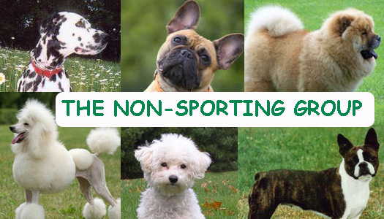
Non Sporting
Number of Breeds: 17
Examples of Breeds: Boston Terrier, Bulldog, Dalmatian, Poodle
Characteristics: Study, vary greatly, bred initially for companionship
Handling Notes: vary greatly

Slide 3
A cheerful, happy dog
Small and sturdy with a dark-eyed inquisitive expression and a plumed tail it carries merrily over the back.
The coat must be white, but may have shadings of buff, cream or apricot around the ears or on the body.
Height: 9-12 inches
Weight: 6-11 pounds
Bichon Frise

Slide 4
Truly an "All- American" dog, the Boston Terrier is a lively and highly intelligent breed with an excellent disposition.
Short-headed and compactly built, and must be black, brindle or seal with white markings
Height: 15-17 inches
Weight: 10-25 pounds
Boston Terrier

Slide 5
Known for their loose-jointed, shuffling gait and massive, short- faced head.
Loveable and popular pets.
Brindle, white, red, fawn, fallow or piebald.
Height: 12-16 inches
Weight: 40-55 pounds
Bulldog

Slide 6
Unique "hippopotamus" head shape, profile and wrinkles, the Shar-Pei is an ancient breed that is usually aloof and standoffish with strangers.
Any solid color is acceptable.
Height: 18-20 inches
Weight: 40-65 punds
Chinese Shar-Pei

Slide 7
Medium in size and muscular with heavy bone.
This lion-like, regal breed comes in five colors - red, black, blue, cinnamon and cream
Is known for its blue/black tongue and stilted gait.
Height: 18-22 inches
Weight: 45-70 pounds
Chow Chow

Slide 8
The only spotted breed, the Dalmatian is alert and active, possessing great endurance, speed and intelligence
Short coat with white and black or white and liver.
Height: 22-24 inches
Weight: 35-70 pounds
Dalmatian

Slide 9
Small, hardy breed with a beautiful cloak of hair that parts down their back from head to tail.
Independent, joyful, and mischievous.
Light blonde to black. Black tipping's on ears and face are also common.
Height: 12-14 inches
Weight: 11-18 pounds
Lhasa Apso

Slide 10
Poodles can be a variety of solid colors, including white, black, apricot and gray, but never parti-colored.
Come in three sizes, hand have hypo allergenic coats.
Height: 18-24 inches
Weight: 40-70 pounds
Poodle

