Slide 1





Shorthaired Cats 1

Slide 3
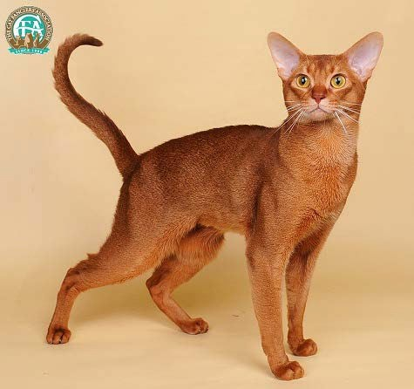
Abyssinian
May be one of the oldest cat breeds.
  Resembles cats painted in Egyptian art.
Reddish brown coat with black ticking.
Abyssinians are extroverted, extremely active, playful, willful and intelligent.

Slide 4
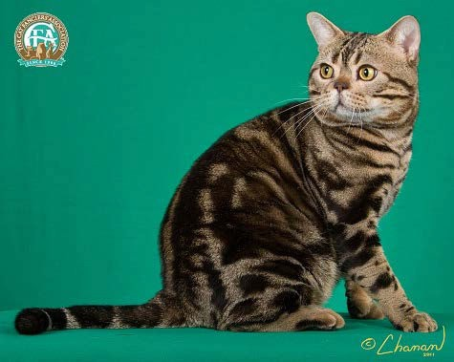
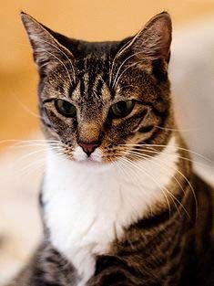
American Shorthair
When settlers sailed from Europe
to North America, they carried cats on board to protect the stores from mice
Athletic, good mice hunters, smart.

Slide 5
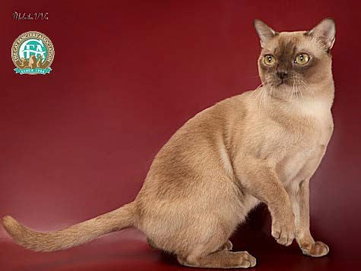
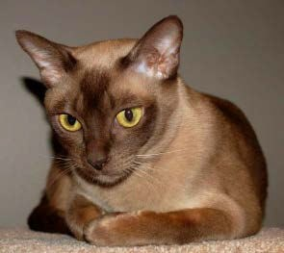
Burmese
Sociable and Friendly with people.
Descended from one female Wong Mau, which was brought from Burma to America in 1930.
Gold to yellow eyes with a satiny coat.

Slide 6
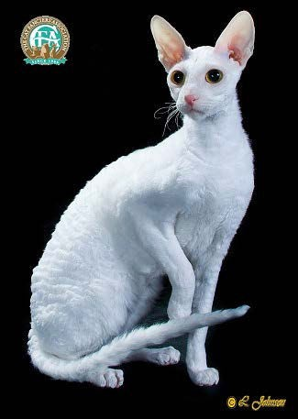
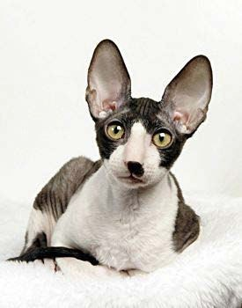
Cornish Rex
Originated in Cornwall England
Coat is very short, lies close to the body and is incredibly soft to the touch.
Affectionate and athletic cat.

Slide 7
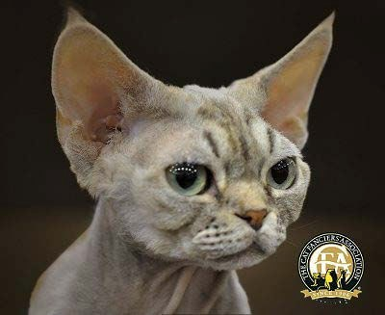
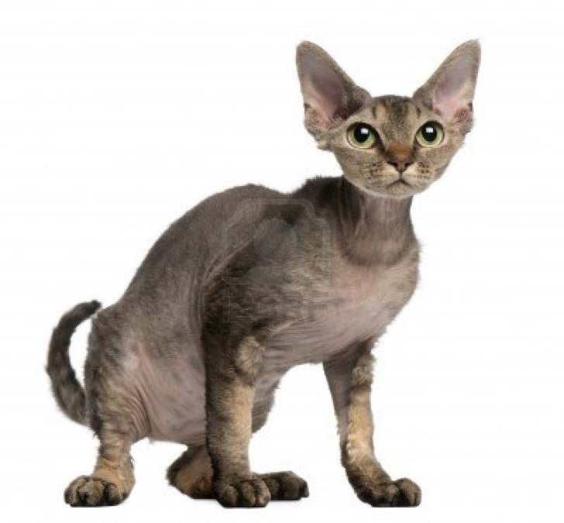
Devon Rex
Oversized ears and an elfish face.
From Devonshire England.
Loyal pets and doglike behaviors.
Coat can be curly to soft suede like.

Slide 8
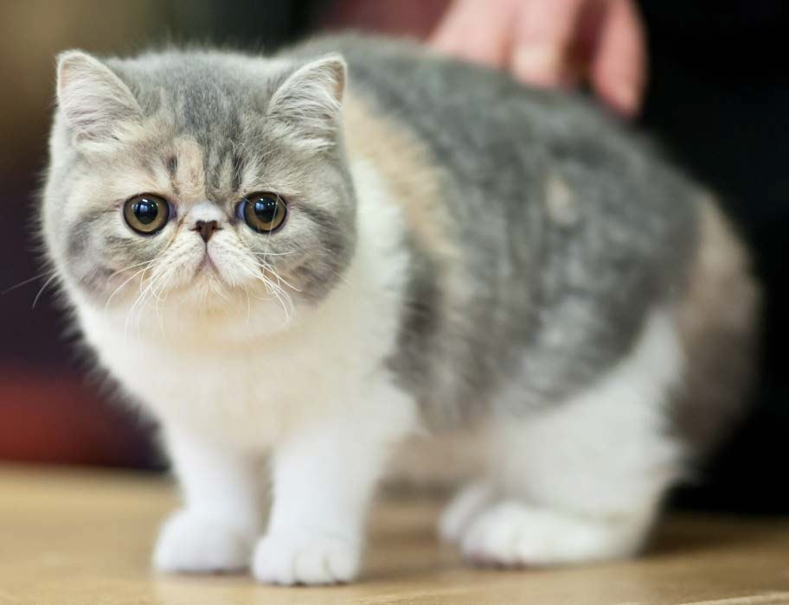
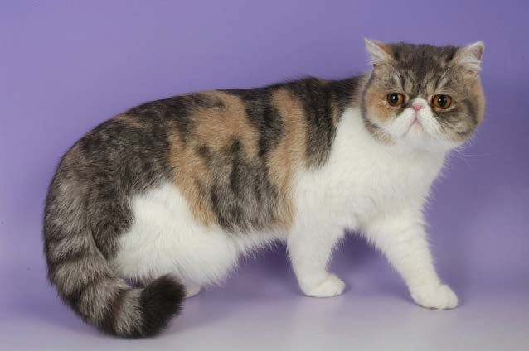
Exotic
Looks like a Persian cat but does not have the long coat or need the amount of grooming.
Soft, round, teddy bear look.
Quiet and loyal companion.

Slide 9
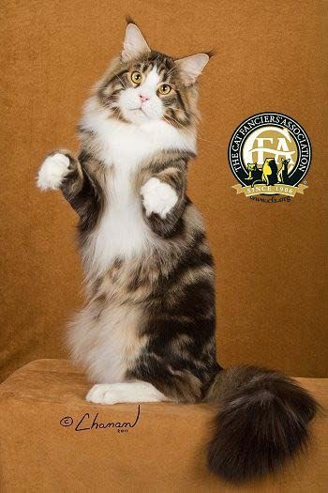
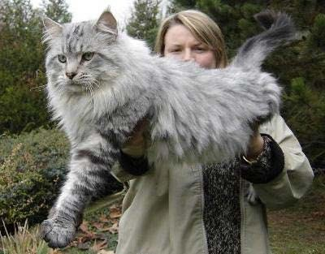
Maine Coon
Intelligent and trainable like a dog.
Native American long haired cat.
Sturdy build with an uneven shaggy coat.
Large well tufted paws and a long fluffy tail.

Slide 10
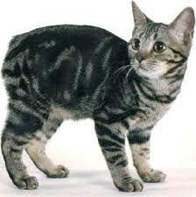
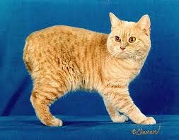
Manx
From the Isle of Mann
Genetic Mutation causes a short tail.
Come in many colors
Prized and skilled hunters.

Slide 11
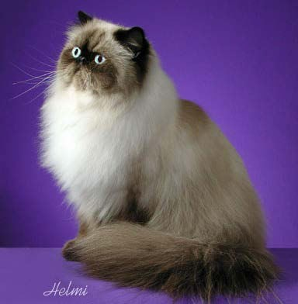
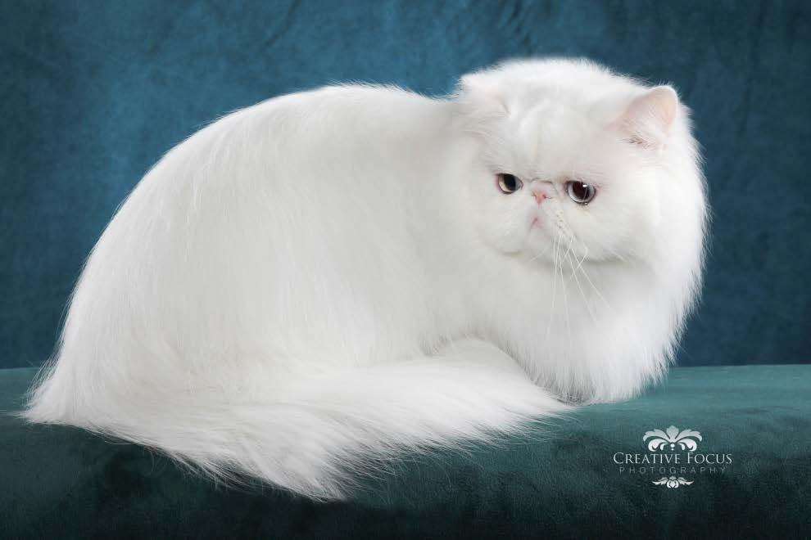
Persian
Originated in Persia and Iran.
Very popular long haired breed.
Sweet gentle personalities and melodious voices.
Broad short bodies and short legs.
  Don’t do much jumping or climbing.

Slide 12
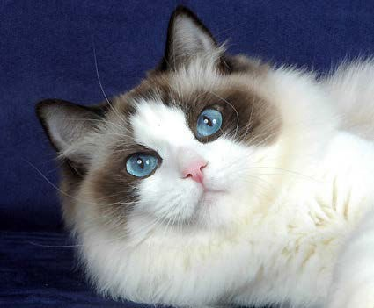
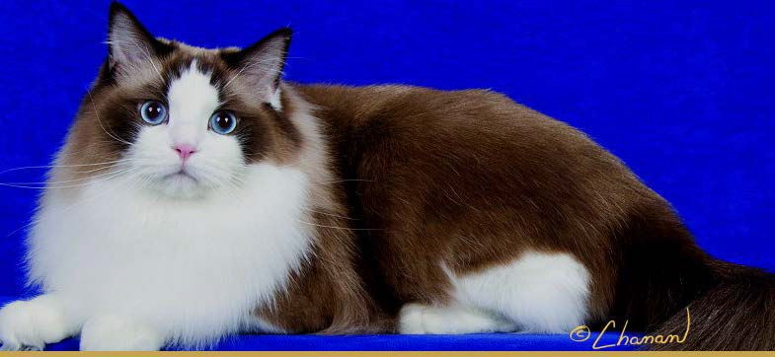
Ragdoll
Large, laidback, semi long haired cat.
Captivating blue eyes.
Body is lighter than the points. (face, legs, tail, ears)
Gentle cats that enjoy being with humans.

Slide 13
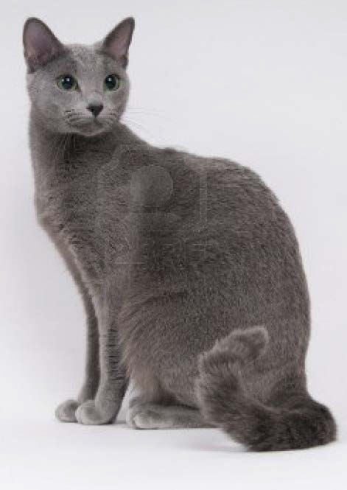
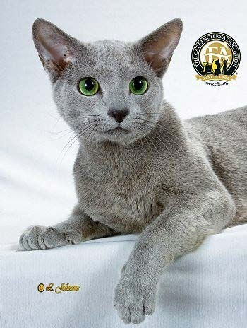
Russian Blue
Silvery blue coat and green eyes.
Intelligent but shy around strangers.
Likes to play fetch.
Quiet cat.

Slide 14
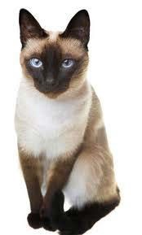
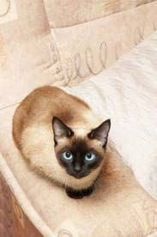
Siamese
From Thailand.
One of the most popular breeds in Europe and the U.S.
Very affectionate
Have a loud low pitched voice

Slide 15
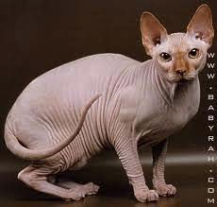
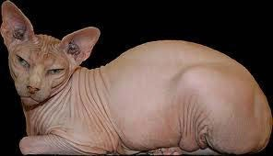
Sphynx
Hairless cat
Large bodies and round bellies.
Extroverted behavior.
Cuddle to stay warm.

Slide 16
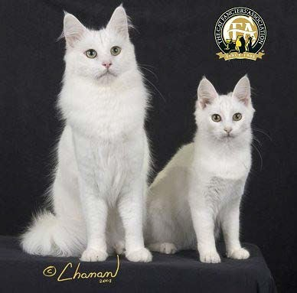
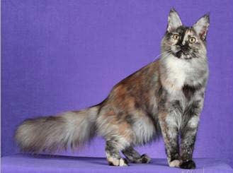
Turkish Angora
One of the most outgoing and affectionate breeds.
Fine boned and elegant looking.
White is the most popular but they do have colored varieties.

Slide 17
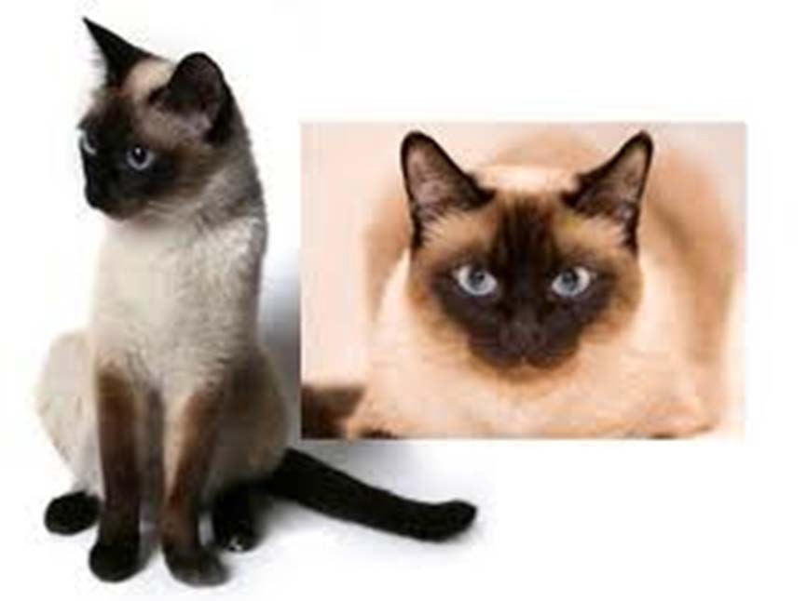
PRACTICE

Slide 18
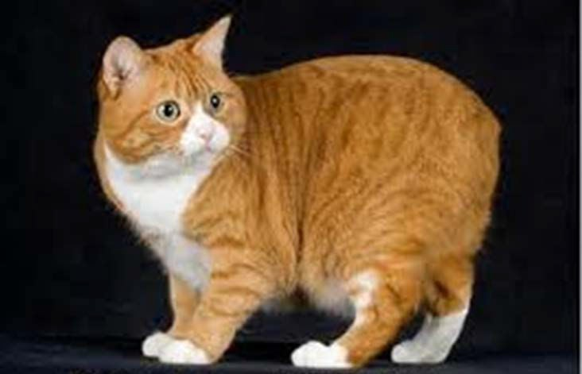
PRACTICE

Slide 19
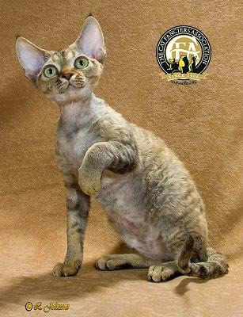
PRACTICE

Slide 20
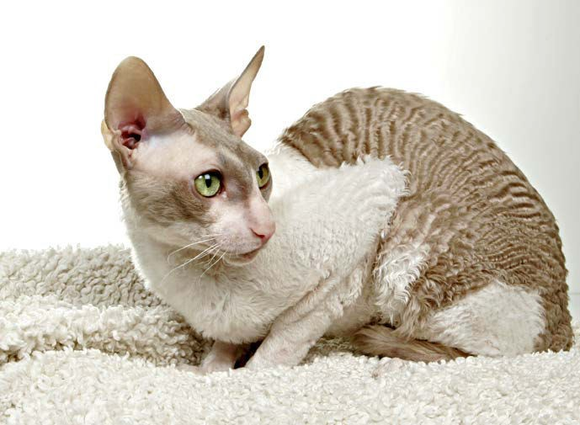
PRACTICE

Slide 21
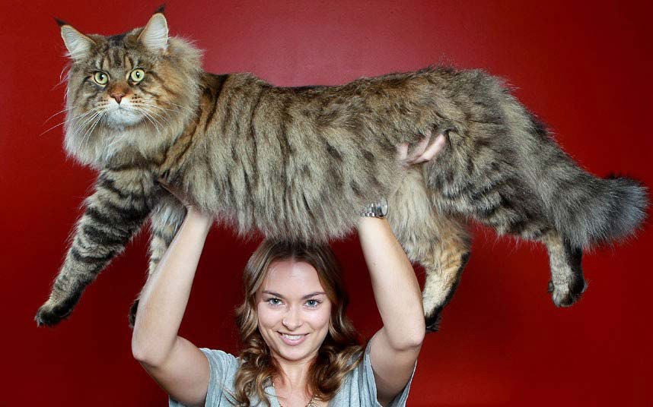
PRACTICE

Slide 22
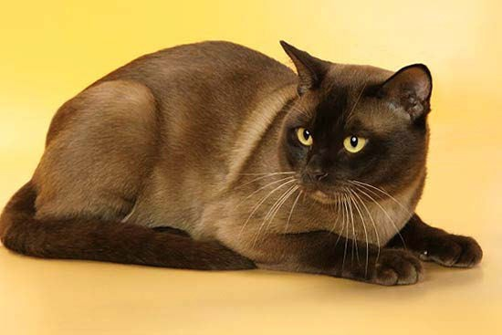
PRACTICE

Slide 23
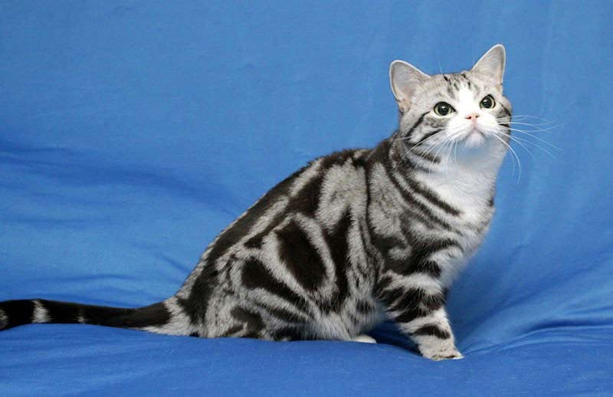
PRACTICE

Slide 24
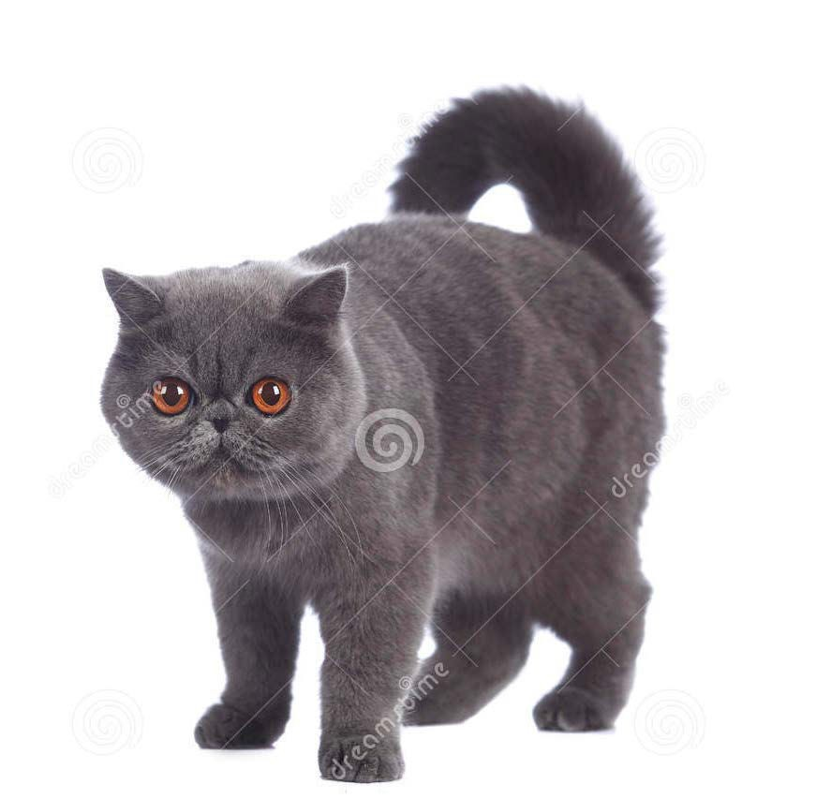
PRACTICE

Slide 25
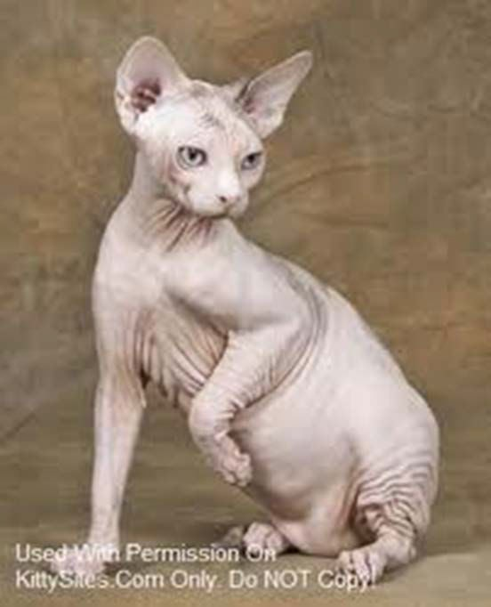
PRACTICE

Slide 26
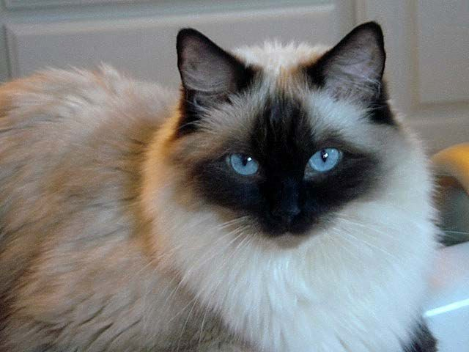
PRACTICE

Slide 27
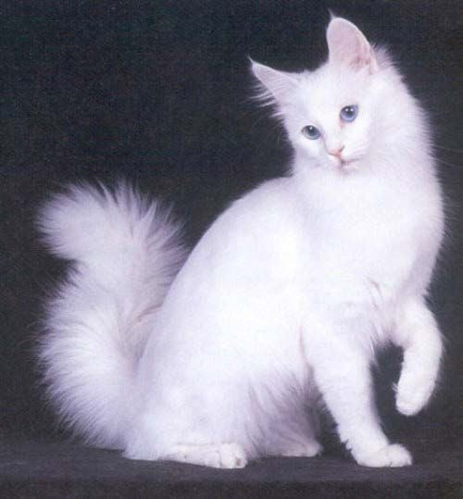
PRACTICE

Slide 28
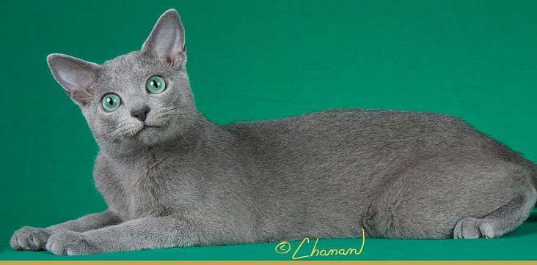
PRACTICE

Slide 29
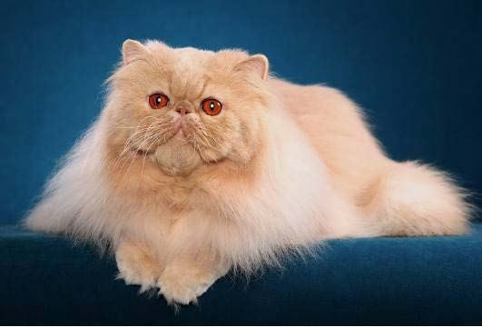
PRACTICE

Slide 30
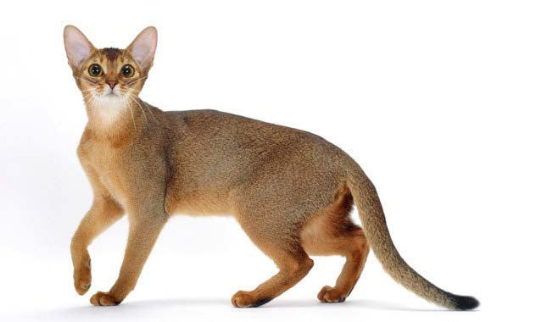
PRACTICE

